Slide 1


Hilma. The Support Center for Disabled Immigrants and Long-term Illness. www.tukikeskushilma.fi
Address: Marjaniementie 74, 5. krs,
00930 Helsinki. Finland
Email: info(at)tukikeskushilma.fi
Presented By
Development Manager. Mahmoud Hassan
Moldova conference 18.11.2025

Slide 2
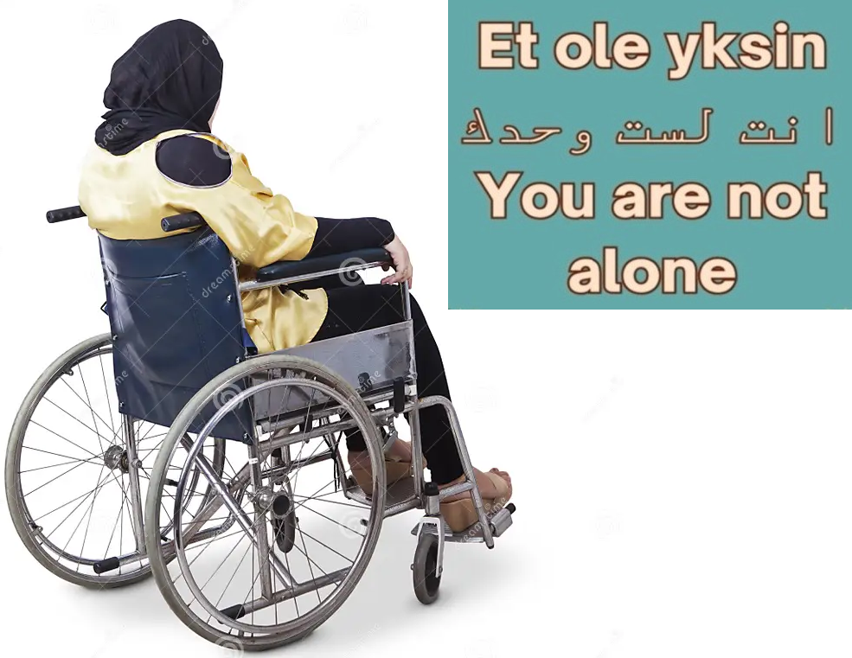

Challenges and opportunities faced by immigrant individuals with disabilities and long-term illnesses in Finland
How Hilma tries to help and effect change
Address: Marjaniementie 74, 5. krs,
00930 Helsinki. Finland
Email: info(at)tukikeskushilma.fi

Slide 3
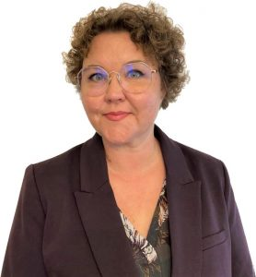
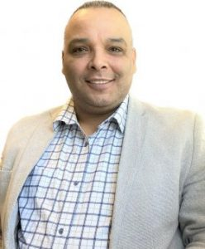
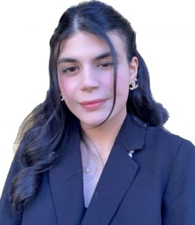
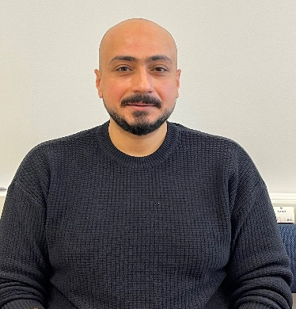
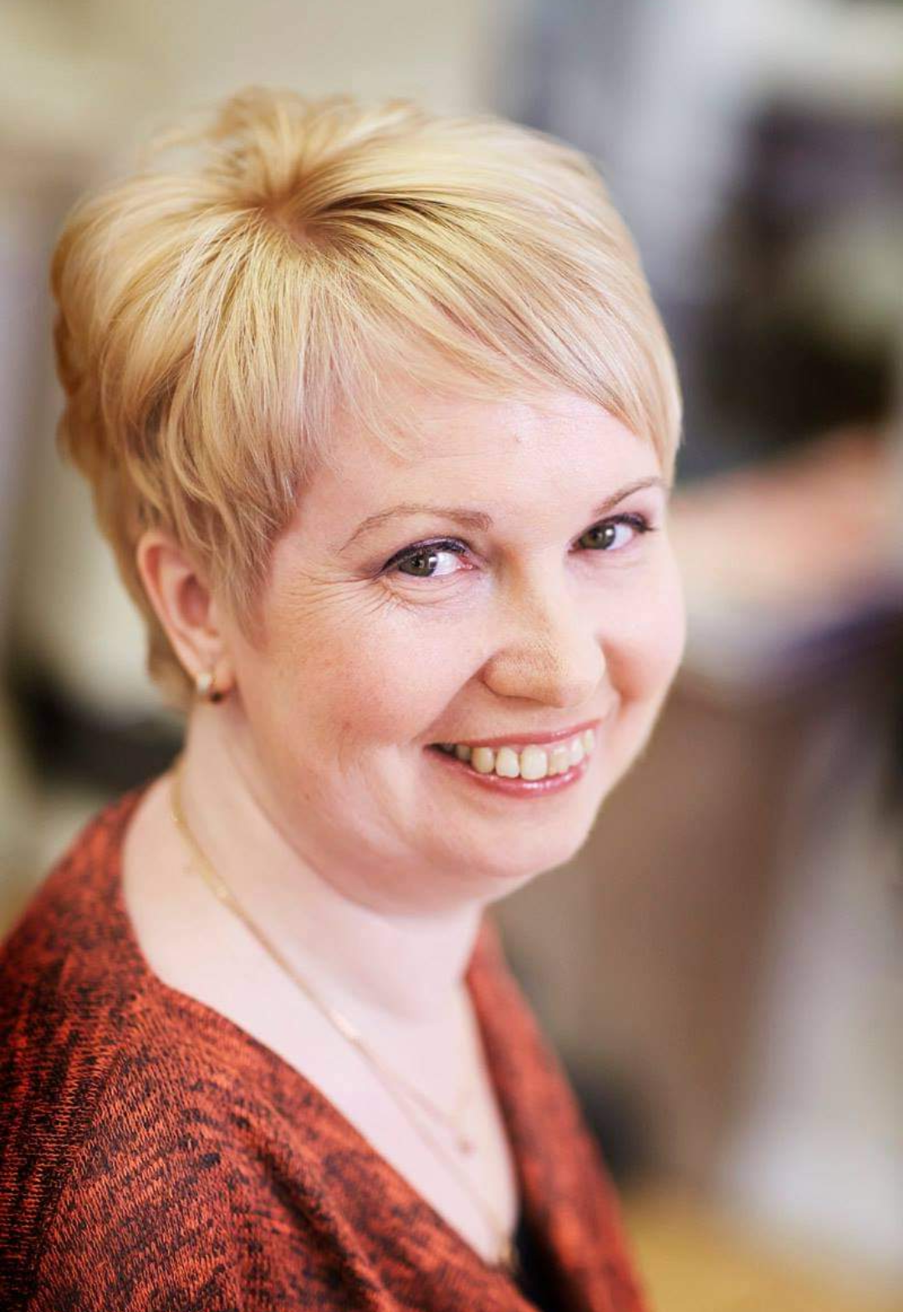
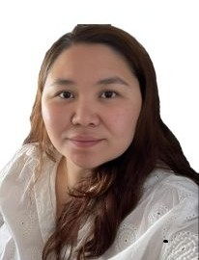


Hilma- the Support Centre for Immigrant Persons with Disabilities
Started as a project at Helsinki Invalid association in 2002
Since 2006 under the Finnish Disability Forum, 20 years
Funded by STEA (Funding Centre for Social Welfare and Health Organisations), Helsinki city and Vantaa-Kerava wellbeing services county (21)
Deveploment manager and 3 Service Advisors, 4 experts, students and work try-out
Serves customers:
  Nationally
  All disability groups and languages
  All immigrant backgrounds
Office location: Helsinki, Iiris Centre (Service and Activity Centre for the Visually Impaired) in Itäkeskus
Notes:
3

Slide 4
HILMA. What do we want to achieve?
Promote the integration and independence of immigrants with disabilities and long-term illnesses
Improve access to services for immigrants with disabilities: Provide easy access and support to disability services in all languages ​​and cultures.
Promote inclusion in society: Support the active participation of immigrants with disabilities in working life, education and social activities.
Support life management and well-being: Provide services that help immigrants live independently and manage their everyday lives.
Improve cooperation between different actors: Develop cooperation networks with authorities, organizations and other actors.
Strengthen the voice of immigrants with disabilities. Support the participation of immigrants with disabilities in decision-making and the defense of their own rights.

Slide 5
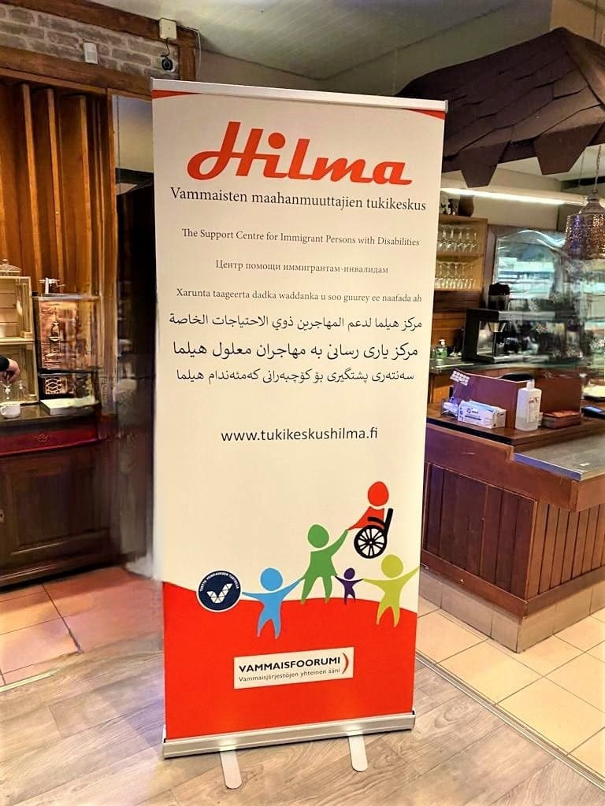
HILMA. What do we do in practice?
Customer service, Advice, guidance and assistance with services and benefits
guidance on applying for services and filling out forms, Peer groups and support
Information sharing.
Awareness of the situation of immigrants with disabilities in Finland
Newsletters, publications, lectures, seminars, Experienced experts
Influencing and Networks, Issuing statements.
Cooperation in projects and networks, Development of the Hilma network.
Development work and Materials:, Disability information, guides, articles, videos
YouTube channel and other online resources
Cooperation with various parties and other organizations such as disability services, Finnish Immigration Service (Migri), Finnish Association for the Visually Impaired, Finnish Association for the Deaf, Finnish Autism Association and Finnish Association for the Disabled and etc...
International Cooperation:
European Disability Forum
Nordic Baltic Network for Organizations working with Newcomers with Disabilities (Finland, Sweden, Iceland, Estonia)

Slide 6
HILMA. Services and rights that we guide and advise our clients to..
Disability services in welfare areas; what is it, applying, complaints, contact, informal care
Kela's disability services and benefits; applying for an EU Disability Card!
Housing issues
Education, Work, work trial, internship
Grants: Support line
Finnish Immigration Service; family reunification, applying for citizenship and deviating from language proficiency!
Tax; Deductions
Car; car tax relief, parking permit
Healthcare; assistive devices, orders (vaccinations, diapers, tube feeding, etc.) Transportation service. "This is how you order or cancel a trip"!!
Hobbies, support people, loneliness, family activities
Current affairs, information in your own language, information about disability, personal matters.

Slide 7
Introduction video to Hilma The Support Center for Disabled Immigrants
https://www.youtube.com/watch?v=fLOvvbgaHgQ&t=2s

Slide 8

Immigrants with disability/ long-term illness in Finland
Quota refugees:
Asylum seekers
Work/studies
Disabled while already in Finland
”Second generation” immigrants
Undocumented persons
2021 a rough estimate of the amount of disabled/long-term ill immigrants in Finland: persons (depending on the severity of the disability) 2-15%
Double minority -> special needs and challenges
Lack of knowledge makes disability
War makes disability
Poverty makes disability
9000– 68 000 persons
Notes:
8

Slide 9
Challenges Faced by Immigrant Individuals with Disabilities
(Knowledge and Information)
Language Barriers
  Difficulty in accessing services and support.
  Understanding and communicating in Finnish (or Swedish, the other official language) can be difficult for immigrants.
  This becomes especially problematic for those with disabilities, as they need to navigate a complex healthcare and social services system to access the support they require.
  Many struggle to understand official documents or communicate effectively with healthcare providers.

Slide 10
Nordic–Baltic Cooperation: Tilheyra Project
Joint NordicPlus initiative across Finland, Estonia, Sweden, and Iceland.
Focus on strengthening disability inclusion in Nordic–Baltic regions.
Supports exchange of knowledge, best practices, and accessible service models.
Promotes equal rights and participation for persons with disabilities.
Hilma contributes Finland’s expertise in disability services and immigrant inclusion.

Slide 11
Hilma’s Role in Tilheyra: CRPD and Everyday Inclusion
Hilma provides expert guidance on the CRPD and its practical meaning.
Explaining CRPD rights in accessible, easy-to-understand language.
Connecting CRPD principles with daily life: accessibility, autonomy, participation.
Highlighting how CRPD supports integration of immigrants with disabilities.
Helping professionals apply CRPD principles in real service structures.
Promoting inclusion and equal opportunities in line with the CRPD.

Slide 12
Challenges Faced by Immigrant Individuals with Disabilities
(Knowledge and Information)
2. Limited Awareness of Rights
  Lack of knowledge about disability rights and support systems in Finland.
  Many immigrants with disabilities in Finland are not fully aware of their rights and the support systems available to them. This lack of awareness can prevent them from accessing essential services and benefits, which are designed to aid in their health, rehabilitation, and integration.
  Most social and financial assistance in Finland is not automatically provided; instead, clients must actively apply for it. Many immigrants with disabilities are unaware of this requirement.

Slide 13
Challenges Faced by Immigrant Individuals with Disabilities
(Knowledge and Information)
3- Access to Healthcare
  Issues with navigating the Finnish healthcare system.
  Immigrants with disabilities or chronic conditions often face difficulties in accessing healthcare.
  This is partly due to administrative challenges, such as understanding the Finnish healthcare system, and partly due to long waiting times, particularly for specialized treatments.
  Many immigrants are unaware of their healthcare rights and the support services available to them

Slide 14
Challenges Faced by Immigrant Individuals with Disabilities
(Knowledge and Information)
4. Cultural Stigma , Social Isolation
  Difficulty in building social networks and support systems.
  Attitudes towards disabilities in different cultures can lead to isolation.
  Cultural stigma surrounding disabilities can significantly impact individuals’ lives, especially among immigrant communities, where attitudes towards disabilities may vary widely based on cultural backgrounds.
  In many societies, disabilities may be misunderstood, stigmatized, or even seen as a source of shame, which can lead to social isolation and reluctance to seek support.

Slide 15
Challenges Faced by Immigrant Individuals with Disabilities
(Knowledge and Information)
5. Employment and Economic Independence, Employment Discrimination.
  Barriers to employment opportunities.
  Many individuals with disabilities or chronic conditions face barriers to entering the workforce. For immigrants, this challenge can be compounded by language skills, lack of recognition of foreign qualifications, and potential discrimination.
  Promoting inclusive employment policies that consider both the immigrant background and disabilities is essential for economic independence and integration.

Slide 16


Opportunities for immigrant individuals
In Finland, disabled immigrants have access to various opportunities for social, educational, and employment integration, thanks to supportive laws and organizations dedicated to inclusivity. Here are some key opportunities: (122 law) !
Service and rehabilitation plans.
Authorities and other bodies like Hilma !
Kela – The Social Insurance Institution of Finland. Social services office.
Financial assistance.
Disability allowance.
Rehabilitation allowance.
Sickness allowance.
Special food and clothing costs.
Housing allowance.
Income support.
Labour market support.
Social loans.
Disability tax reduction.
Mental health services.
Organizations and associations.
Applying for services.
Applications and decisions.
Appealing a decision.

Slide 17
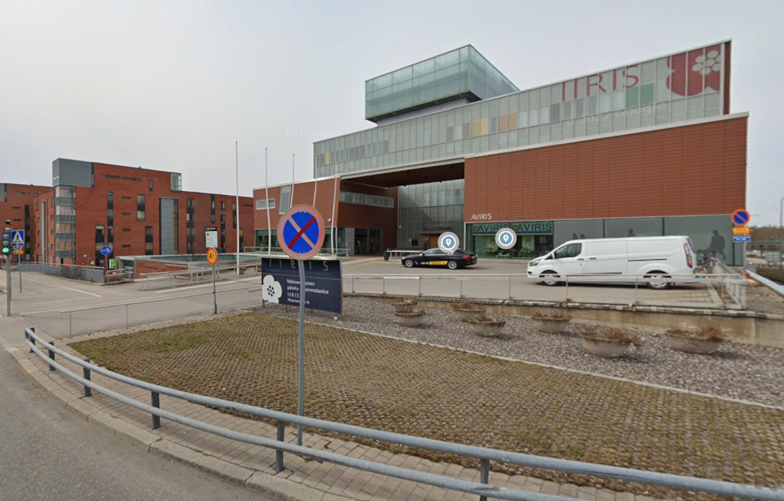
Vammaisten maahanmuuttajien tukikeskus Hilma
Iiris-keskus,
Marjaniementie 74, 5. krs,
00930 Helsinki (Itäkeskus)

Slide 18






Facebook, website, youtube
https://www.facebook.com/palveluneuvoja.tukikeskushilma
https://www.tukikeskushilma.fi/
https://www.youtube.com/channel/UC47tYsN75npR_UQNWE-LimA
https://www.instagram.com/tukikeskushilma/?hl=fi
https://twitter.com/search?q=tukikeskushilma&src=typd
Newsletter: https://tukikeskushilma.fi/

Slide 19
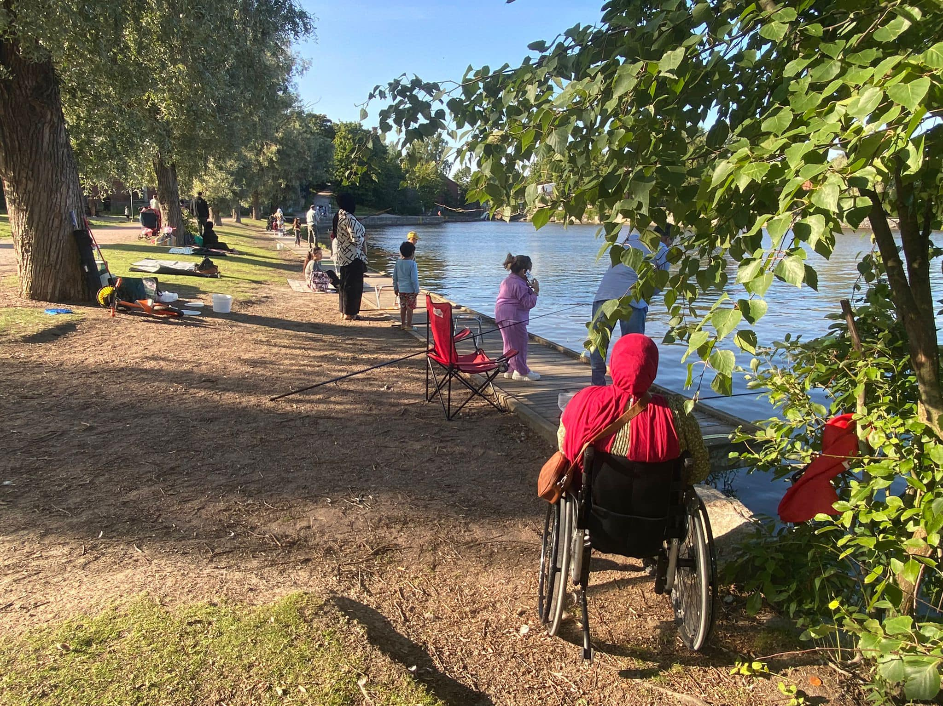
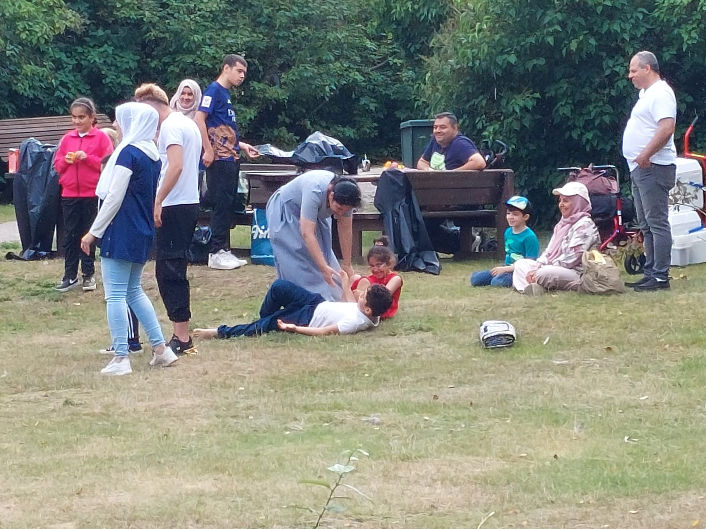
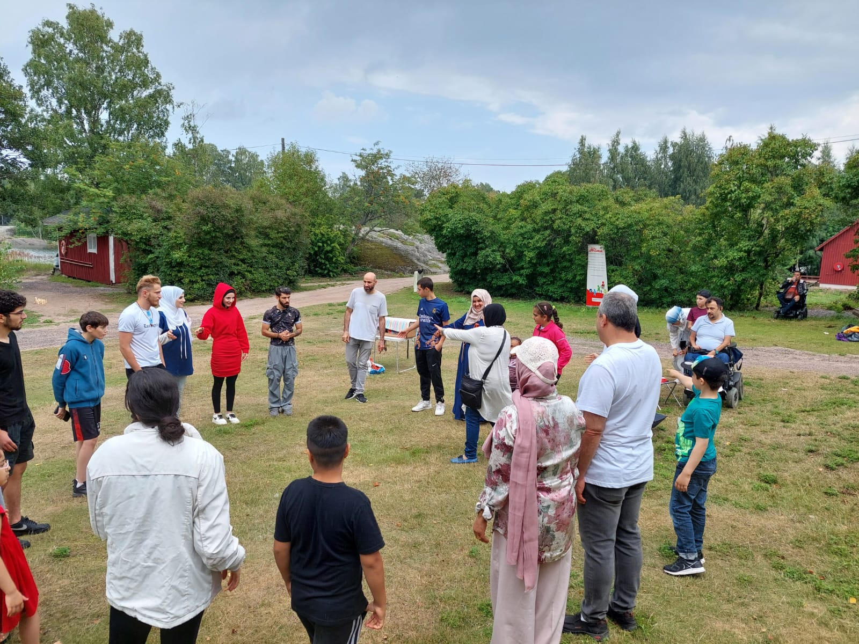
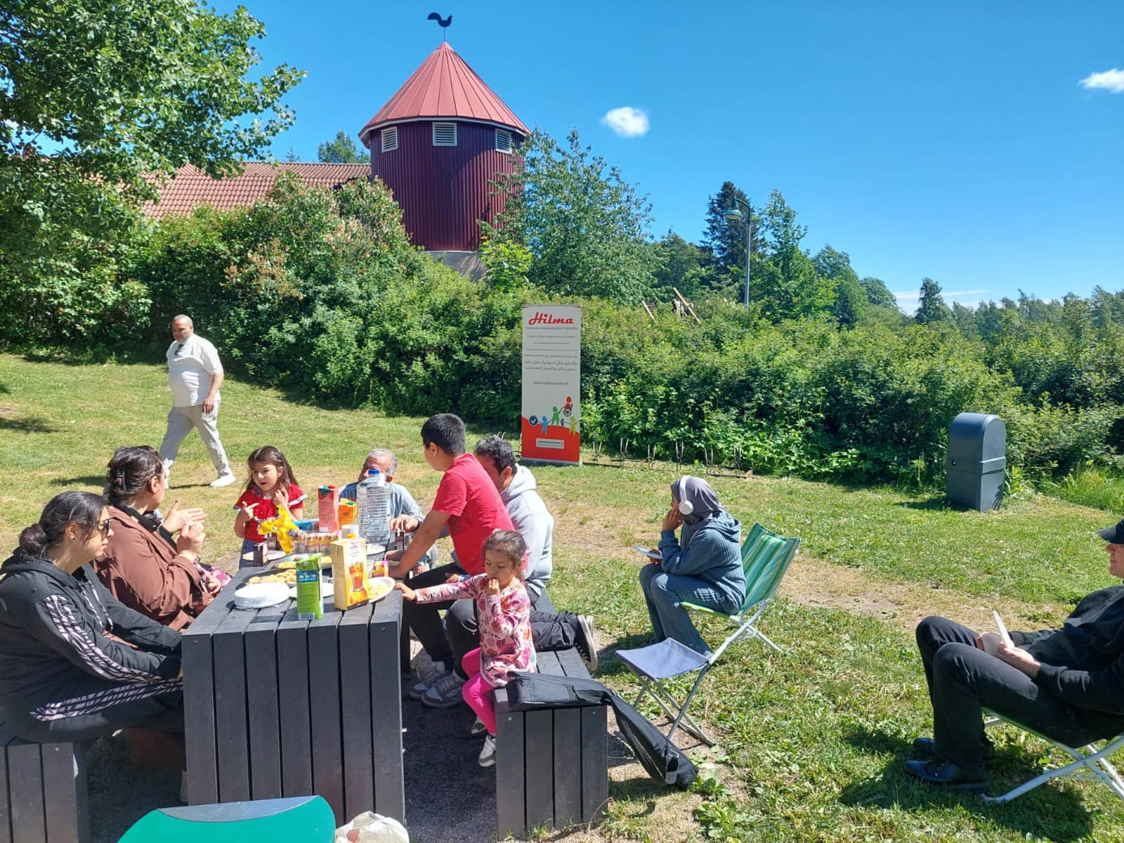

Slide 20

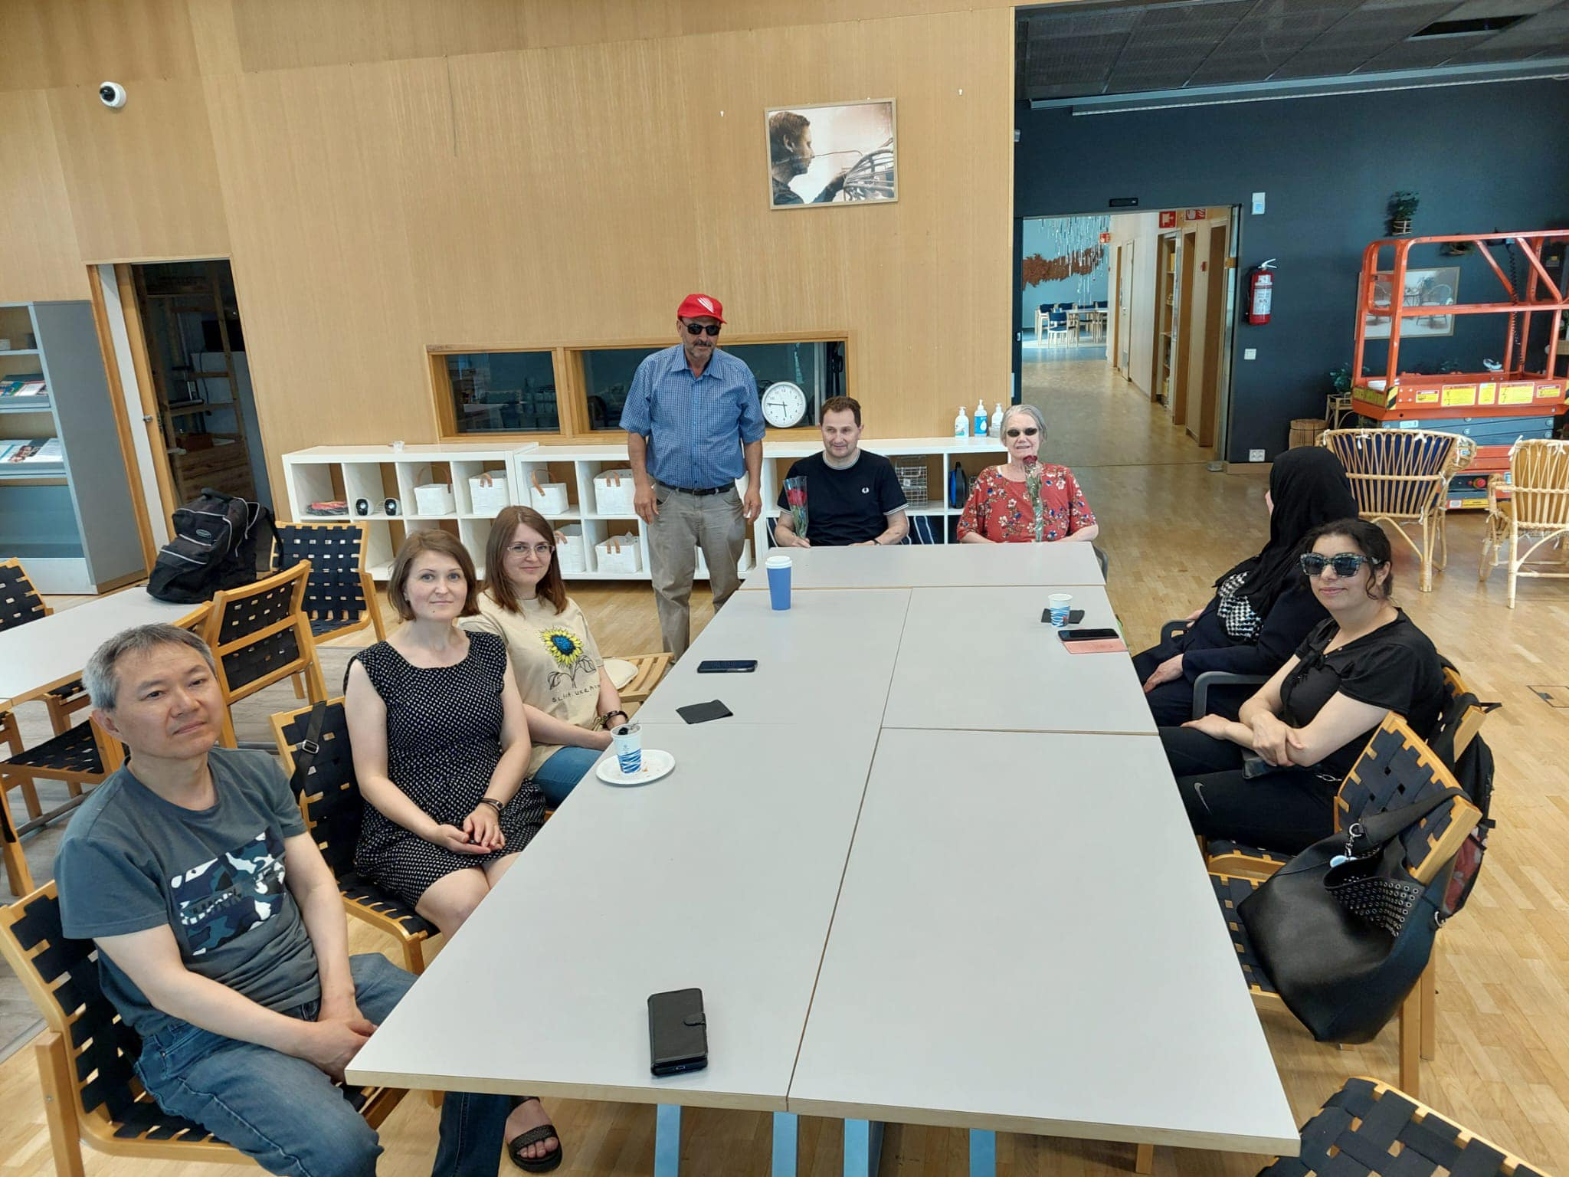
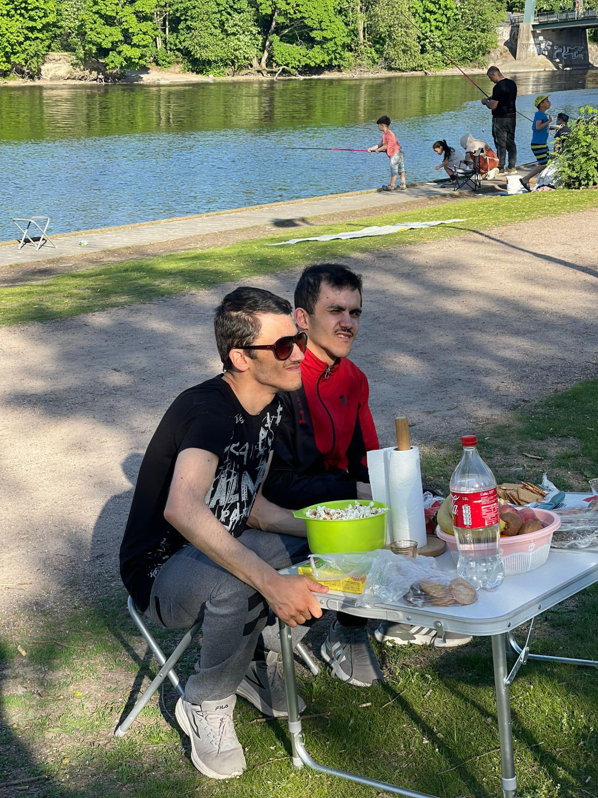
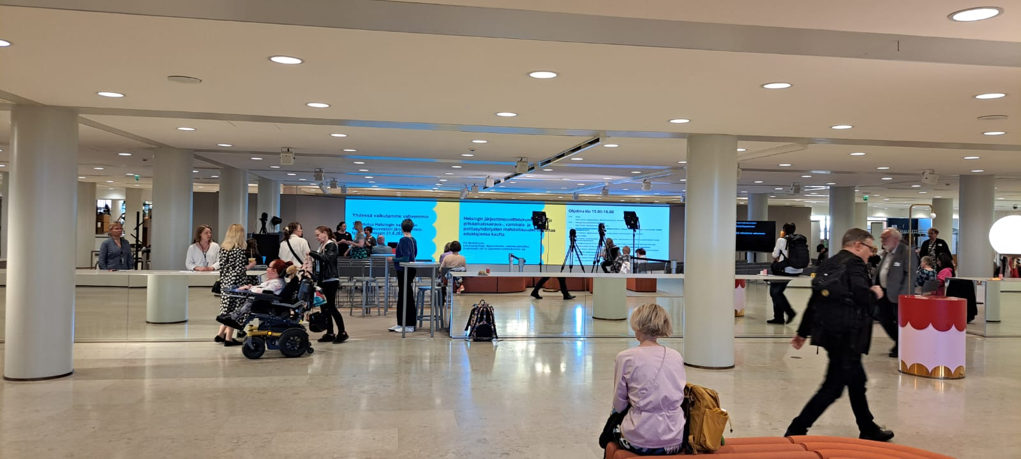

Slide 21
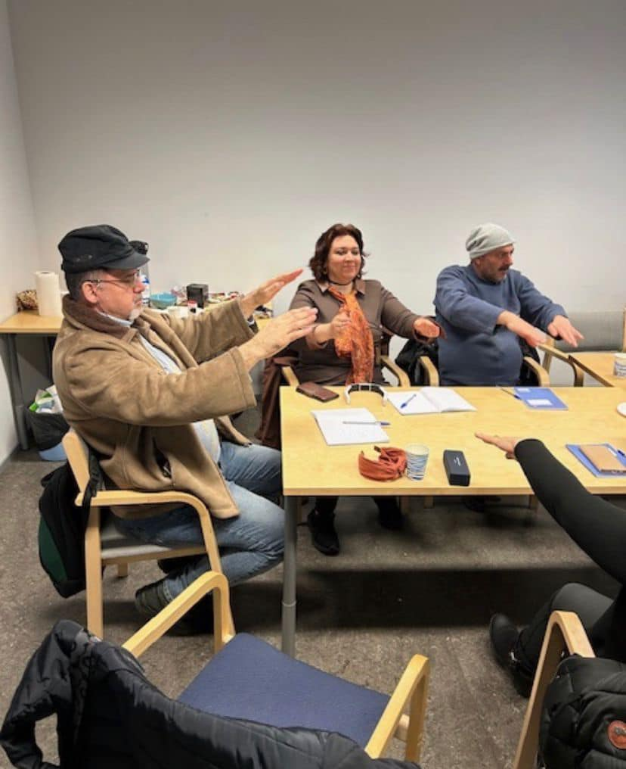
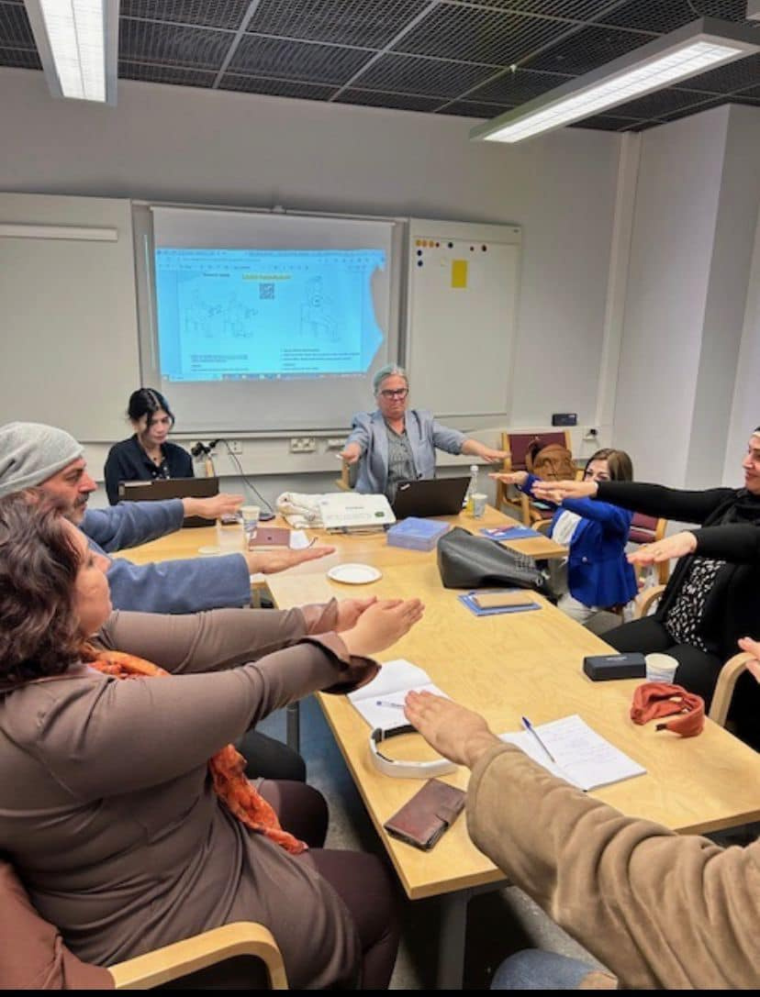
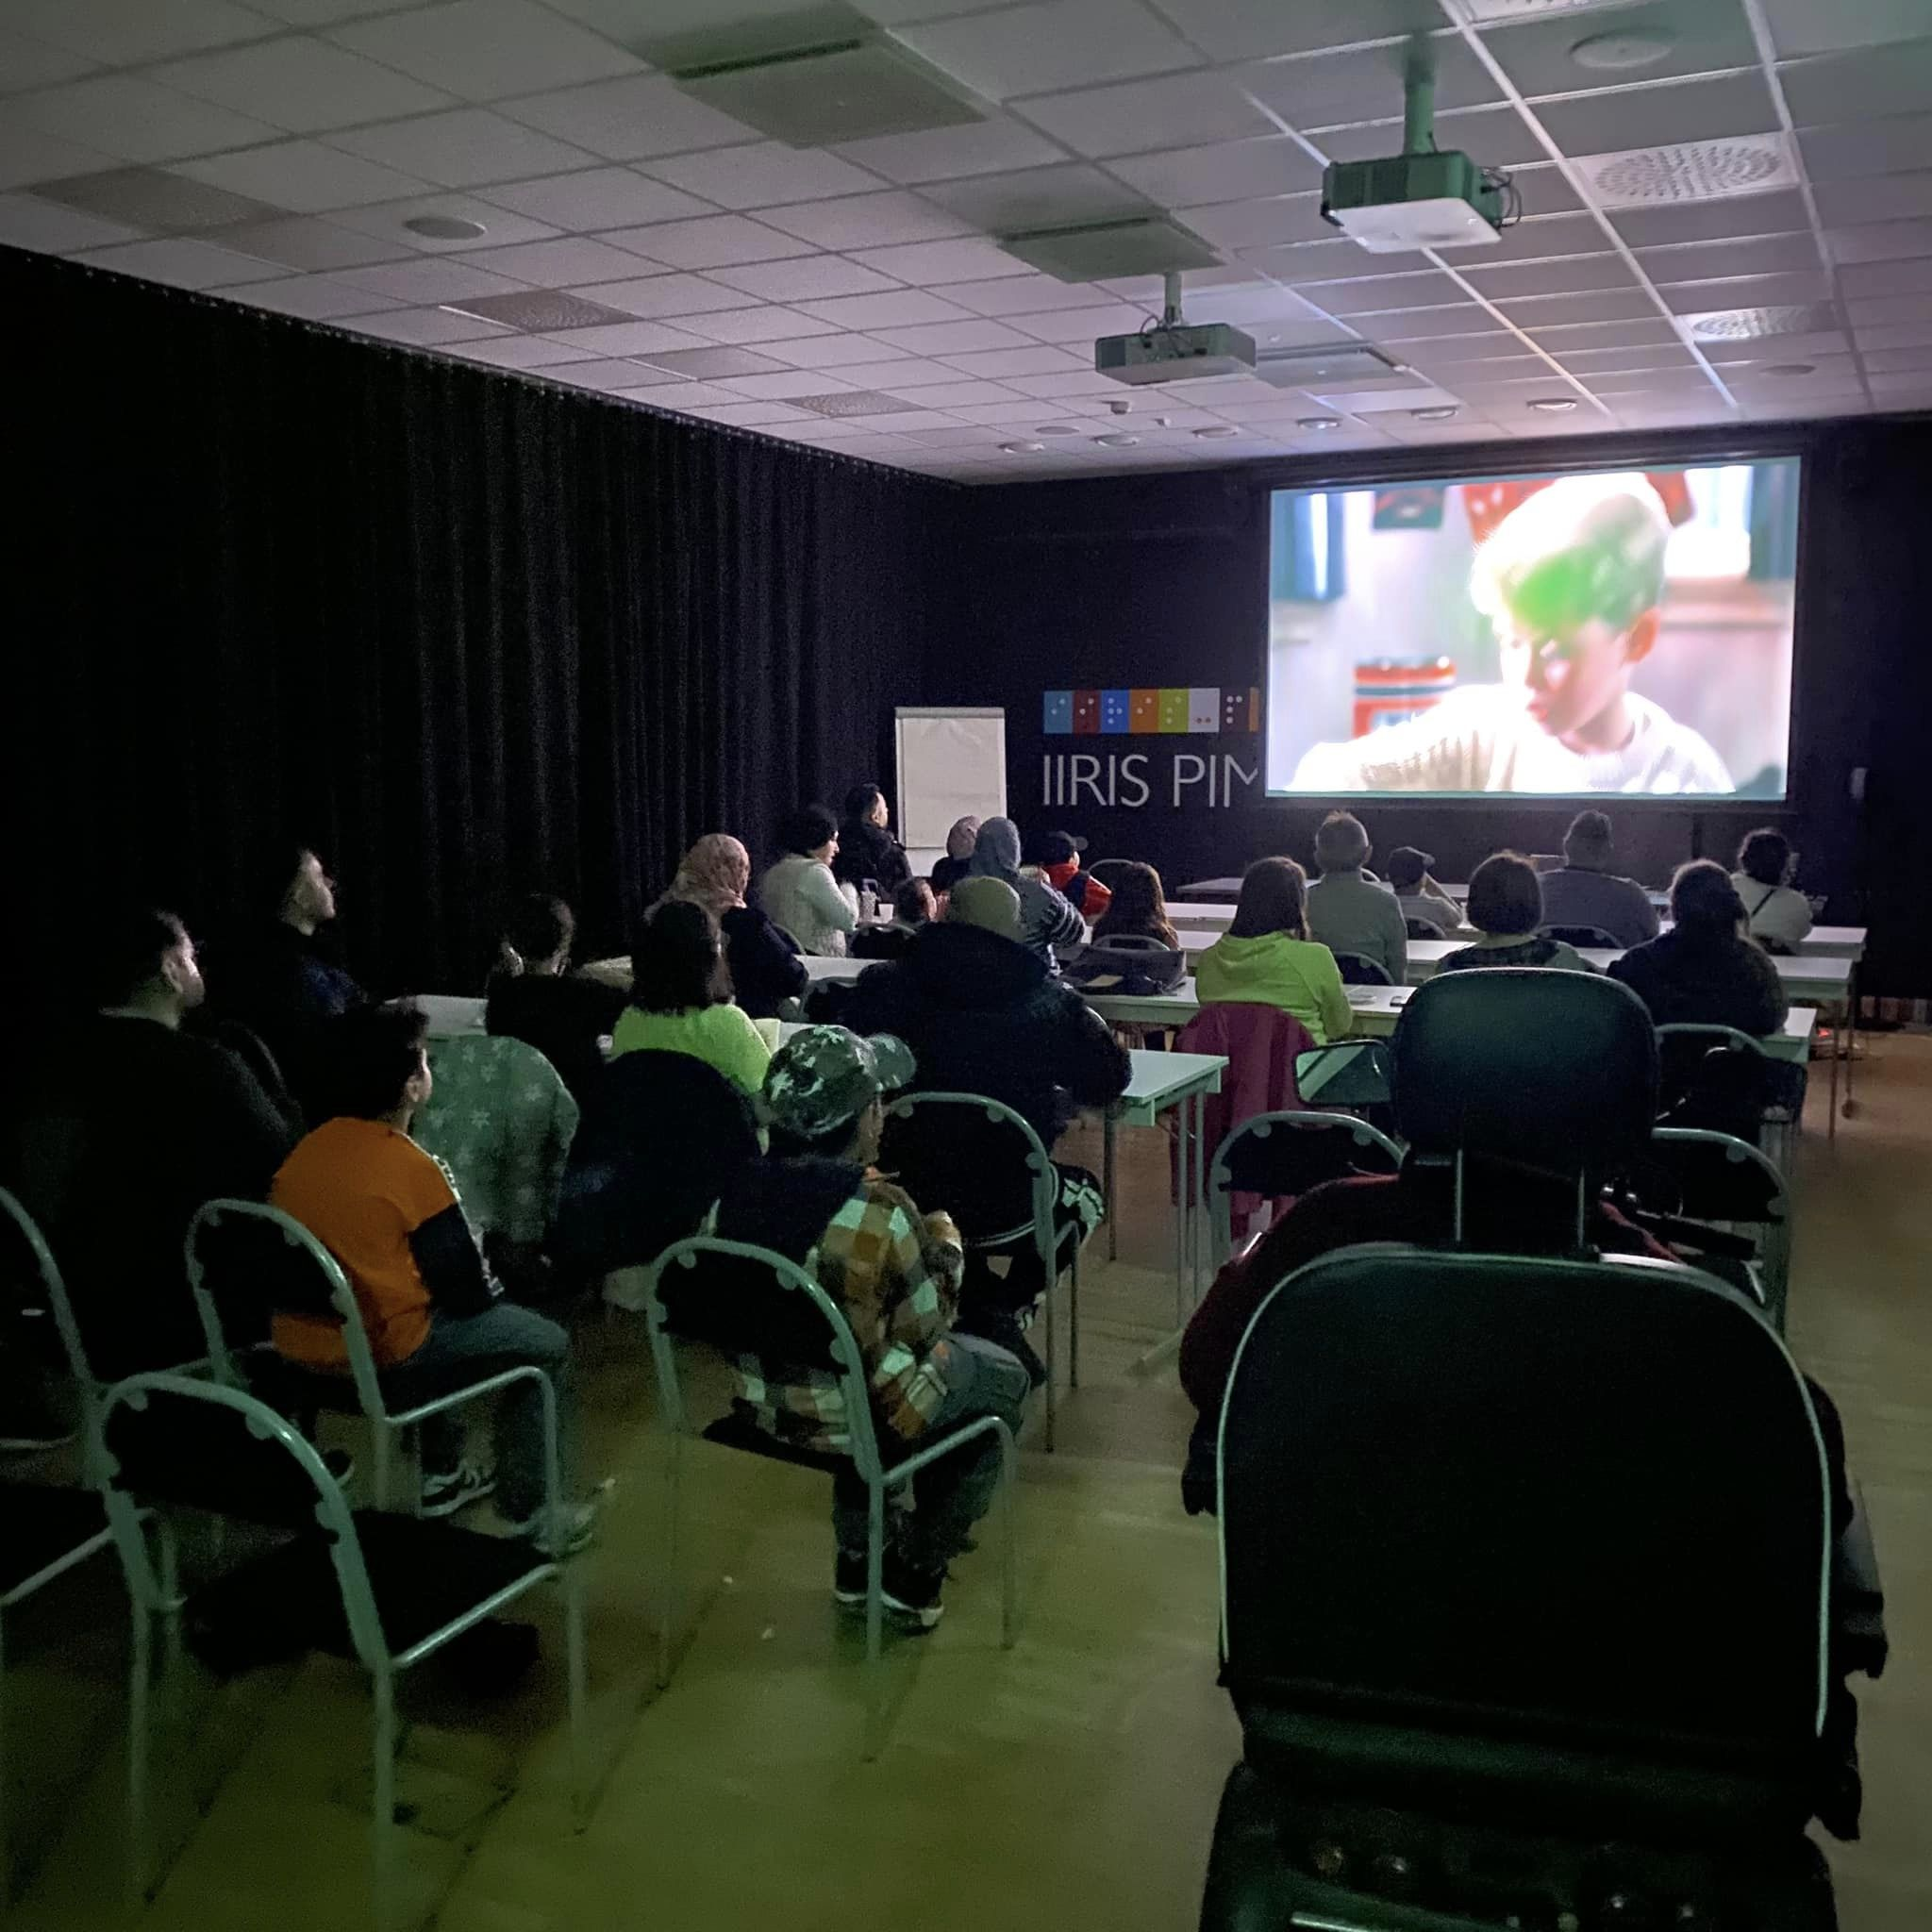
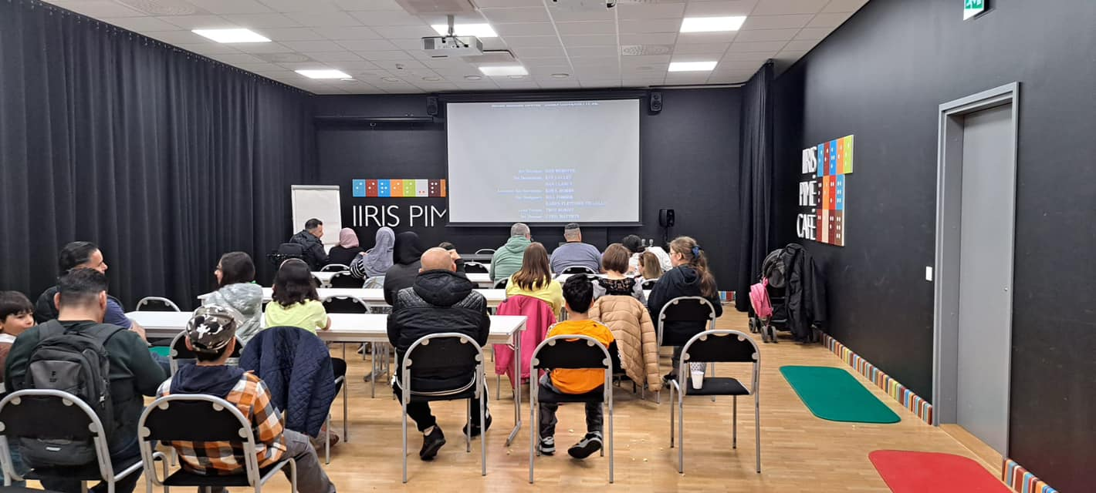

Slide 22
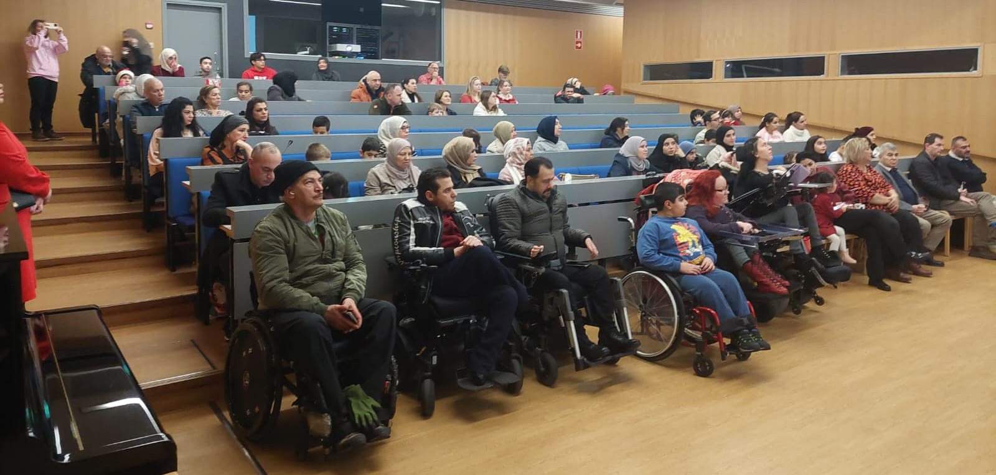
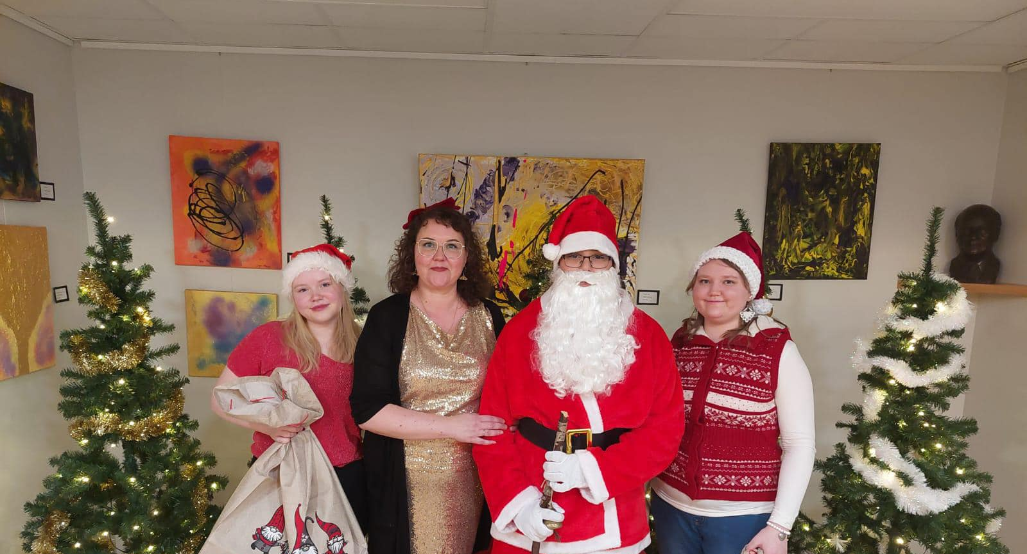
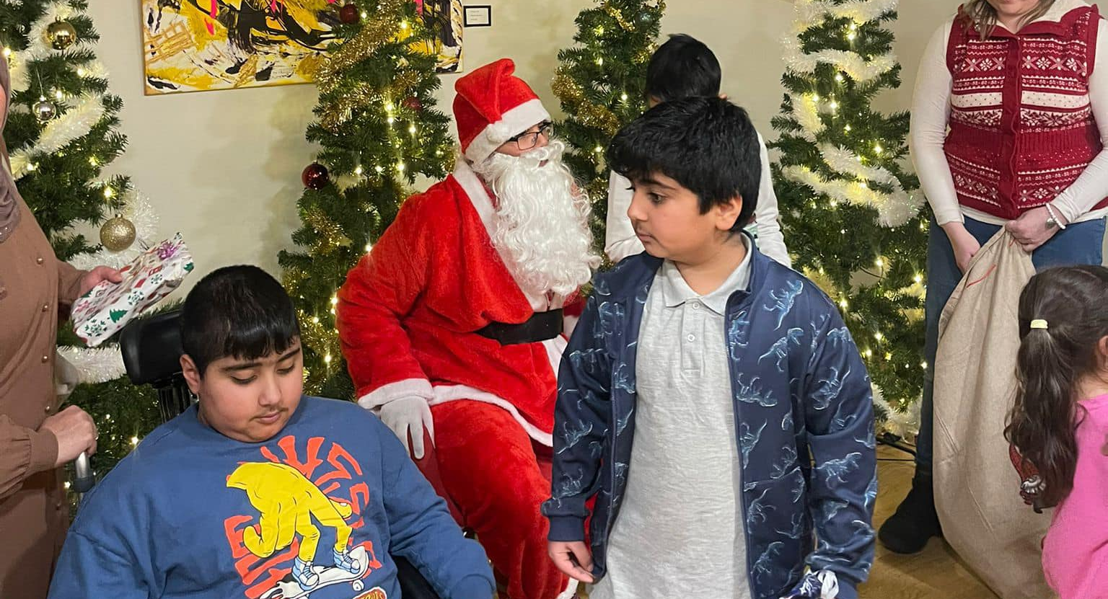
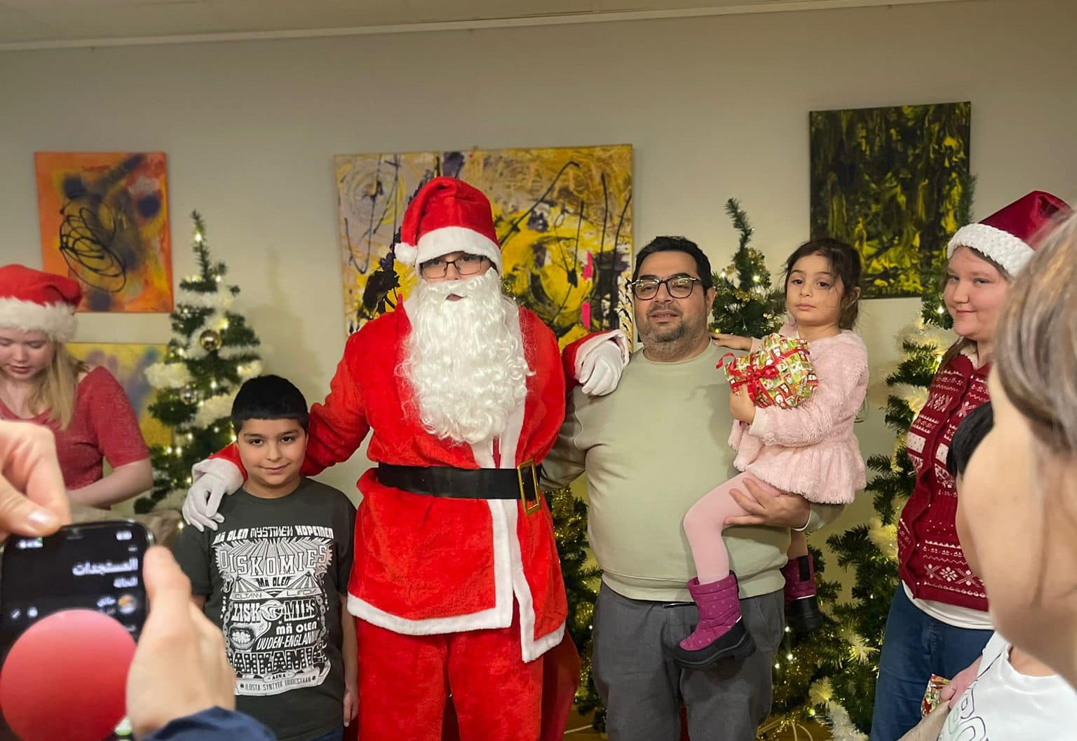
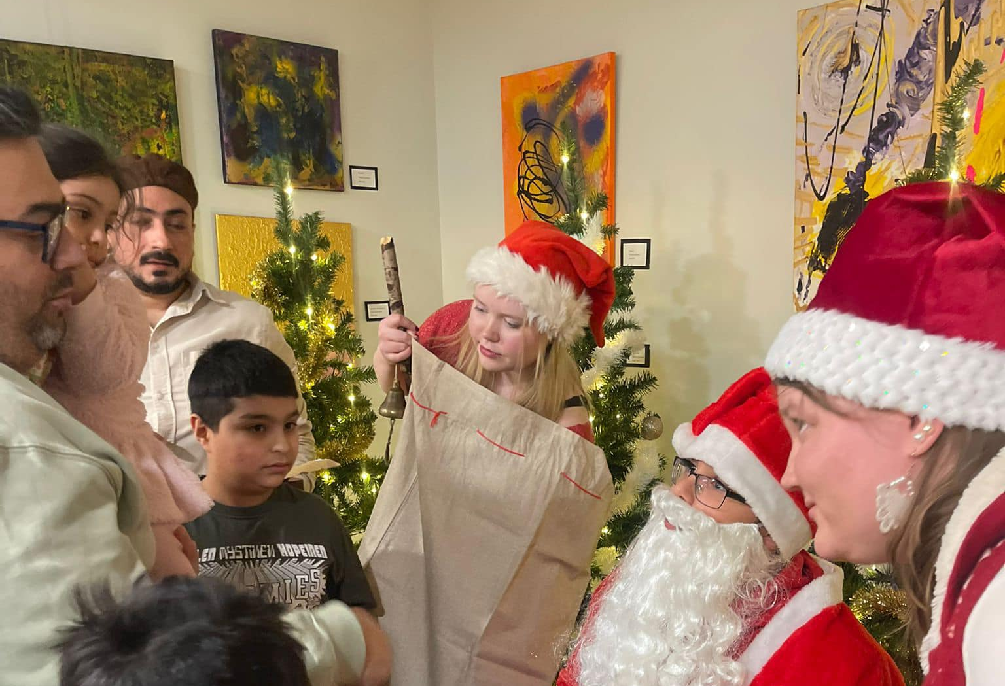
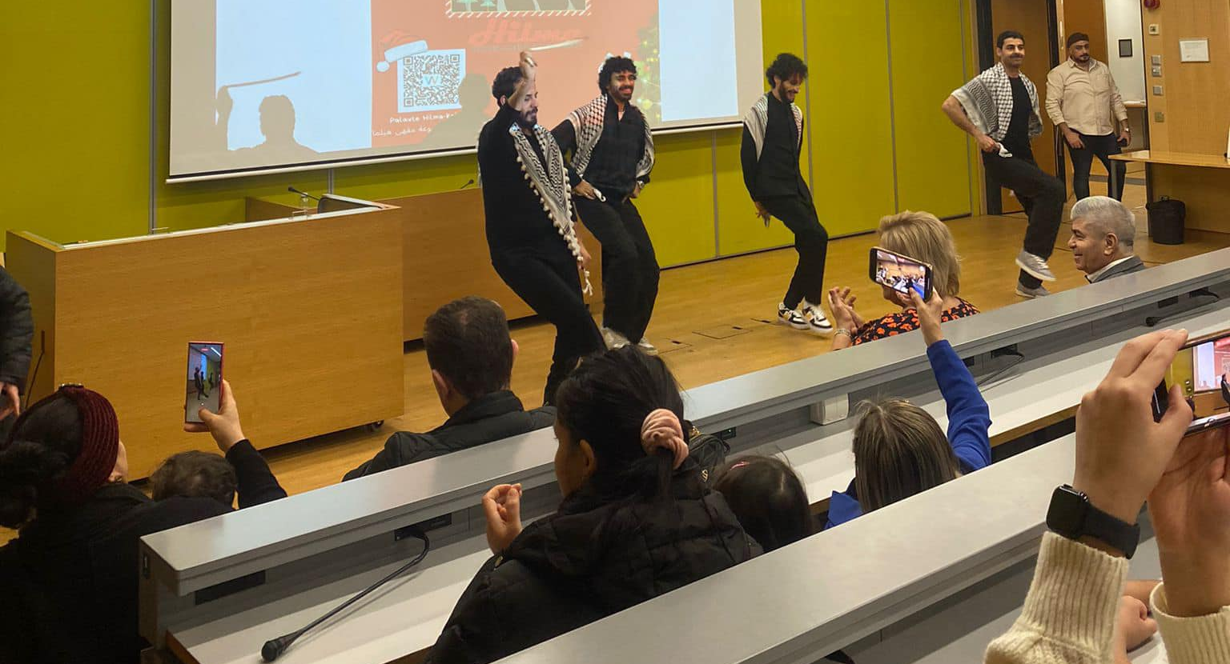

Slide 23
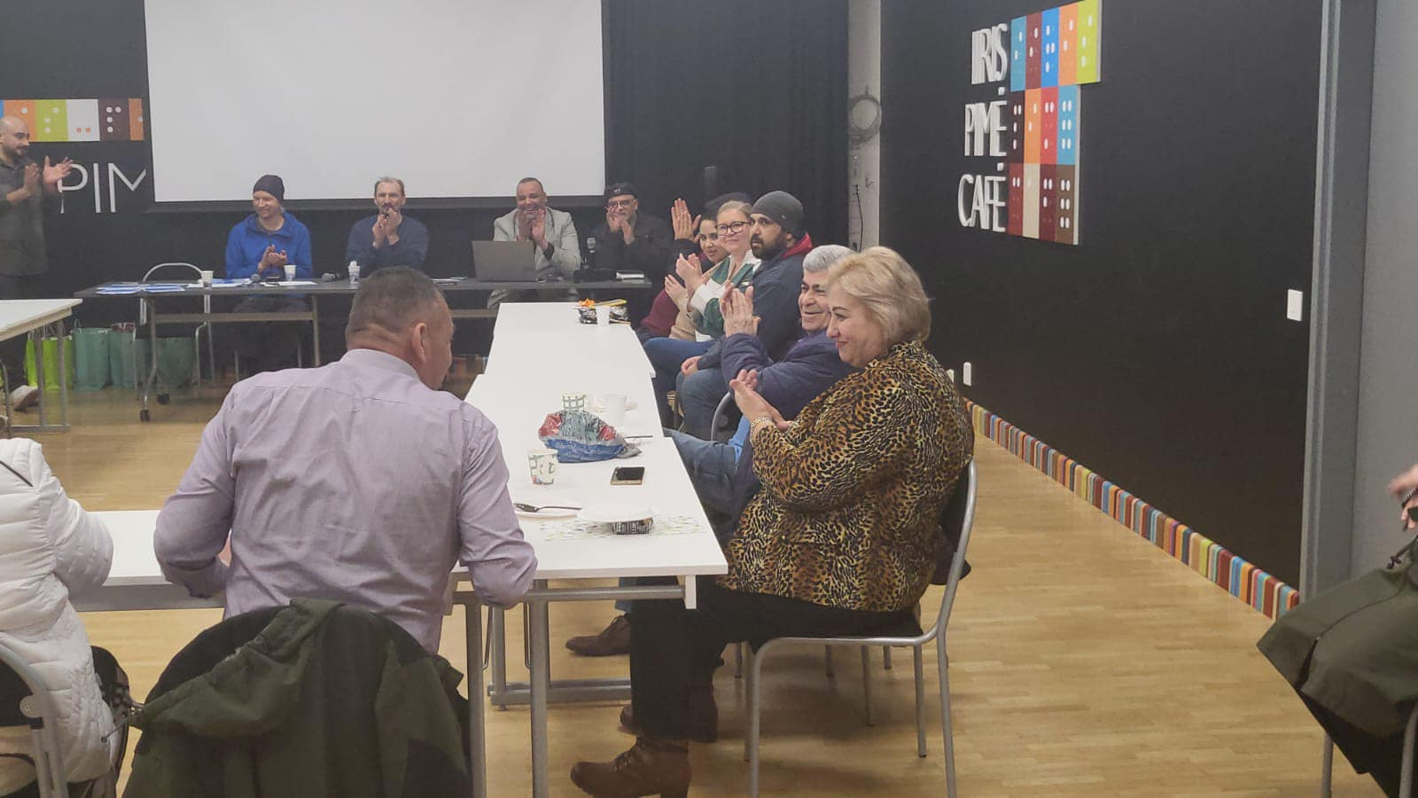
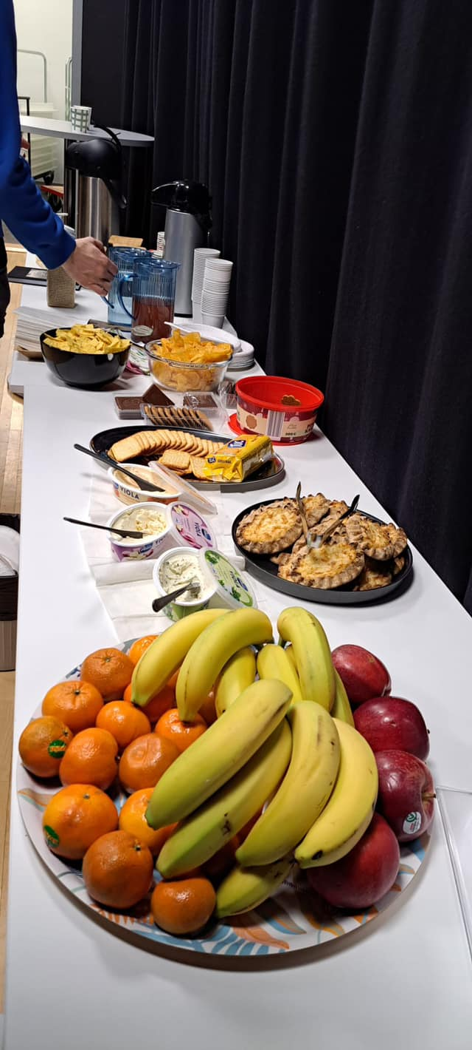
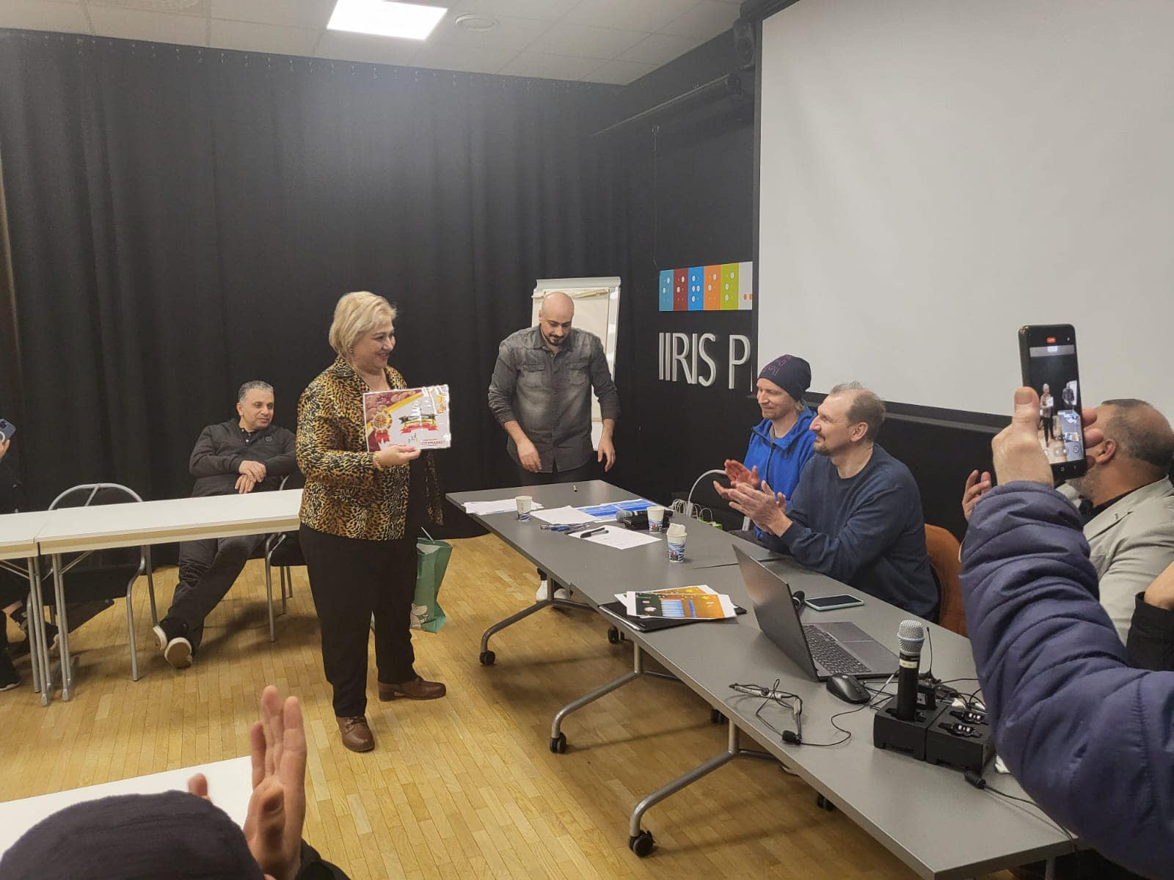
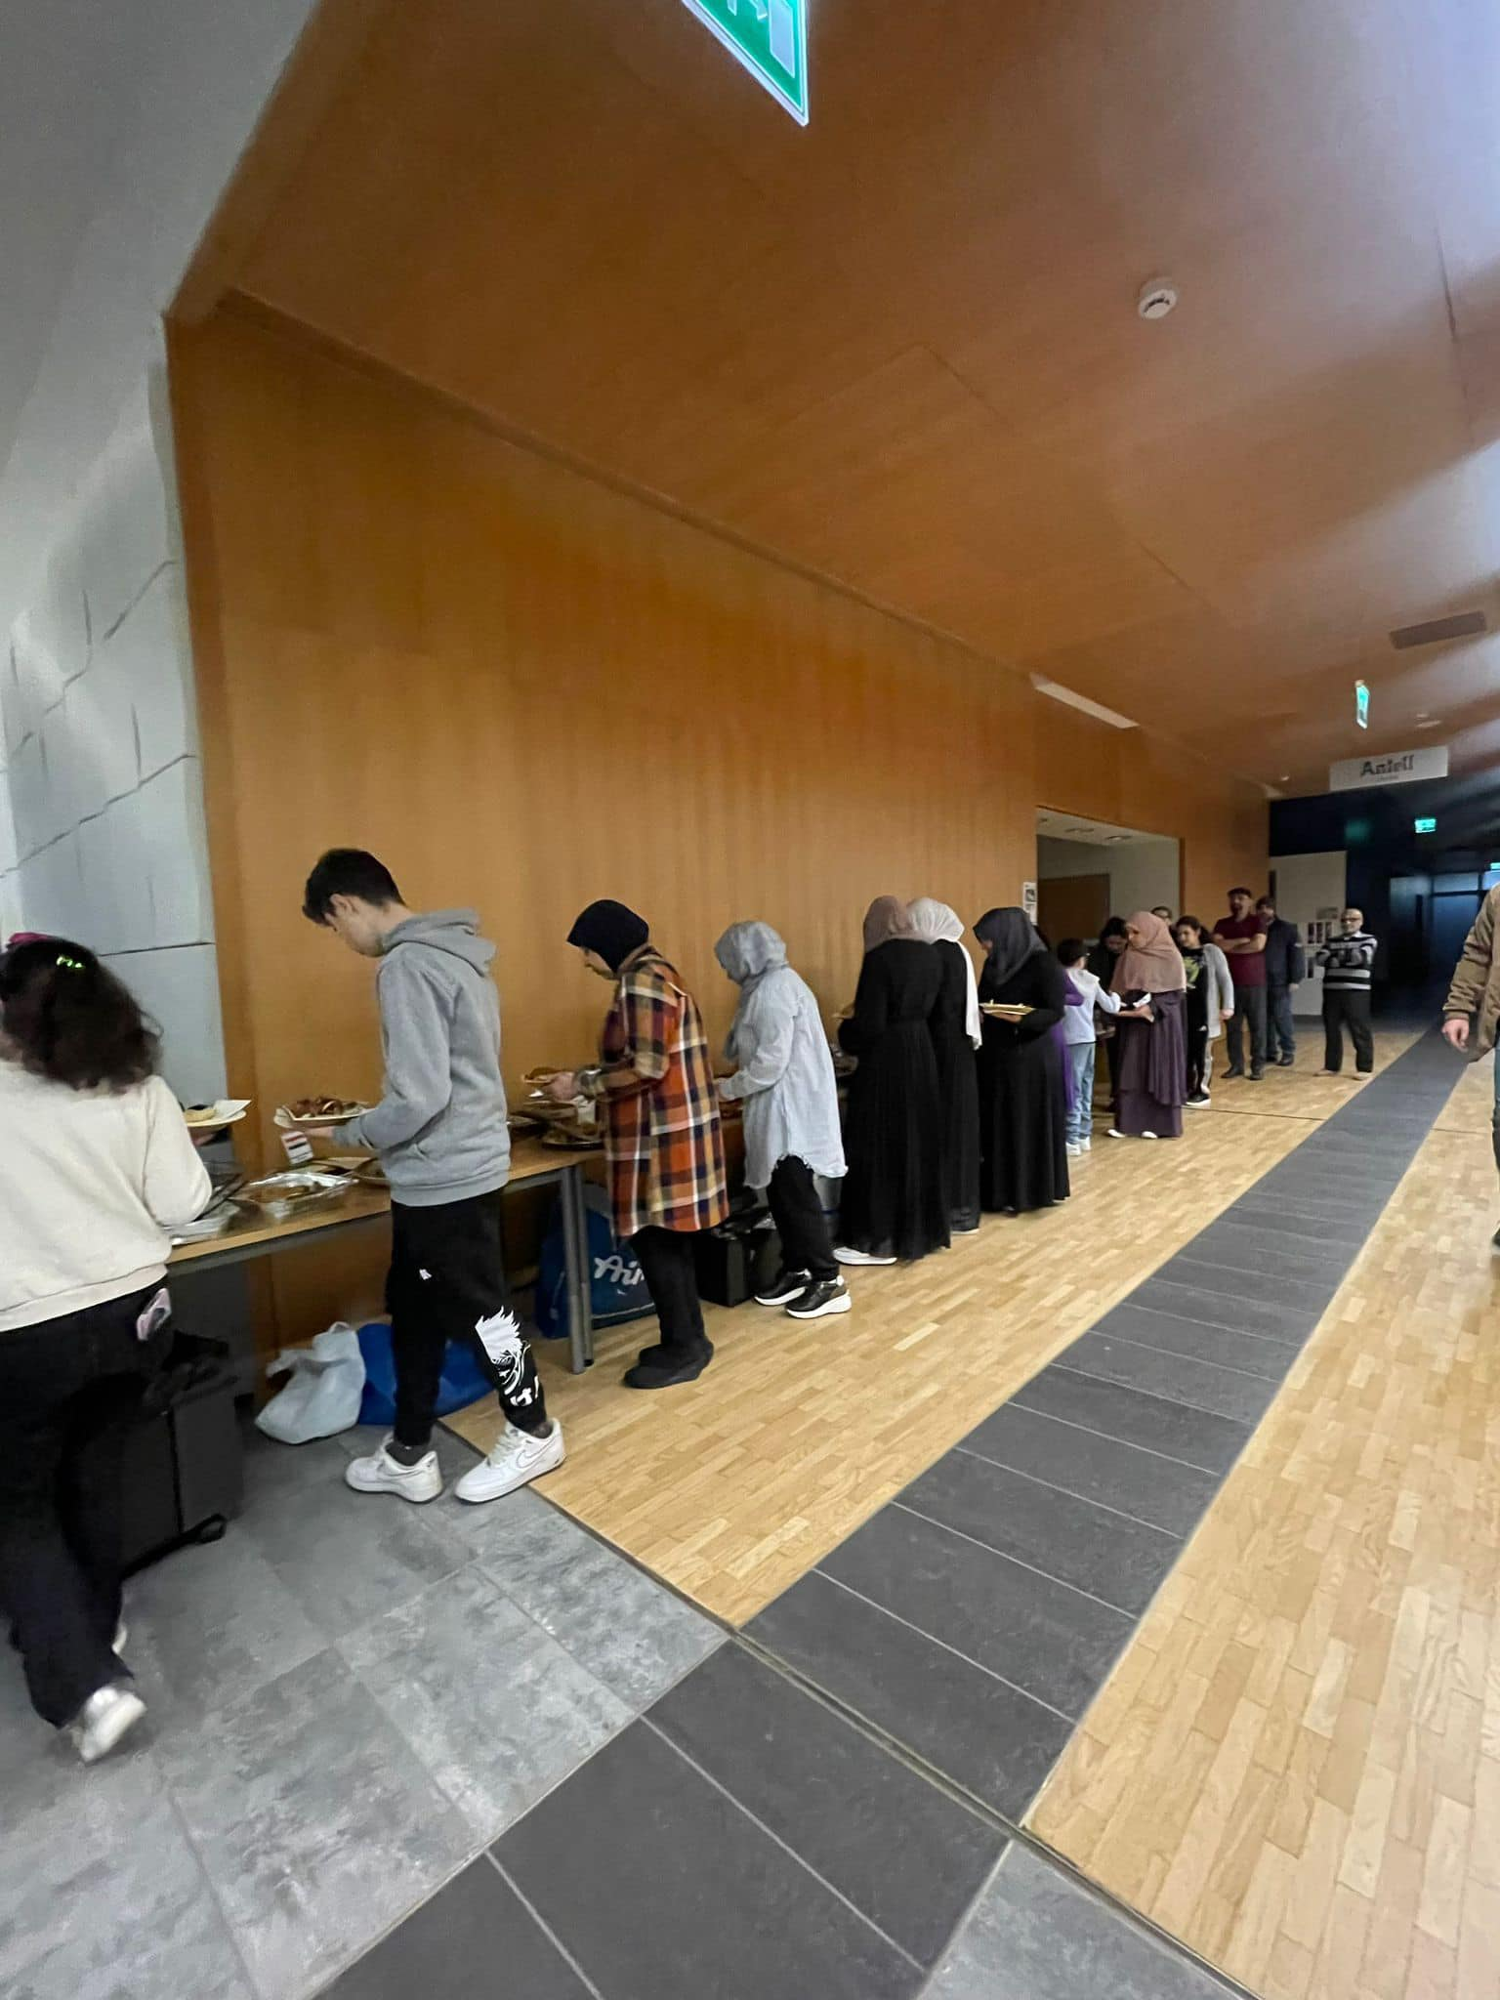

Slide 24
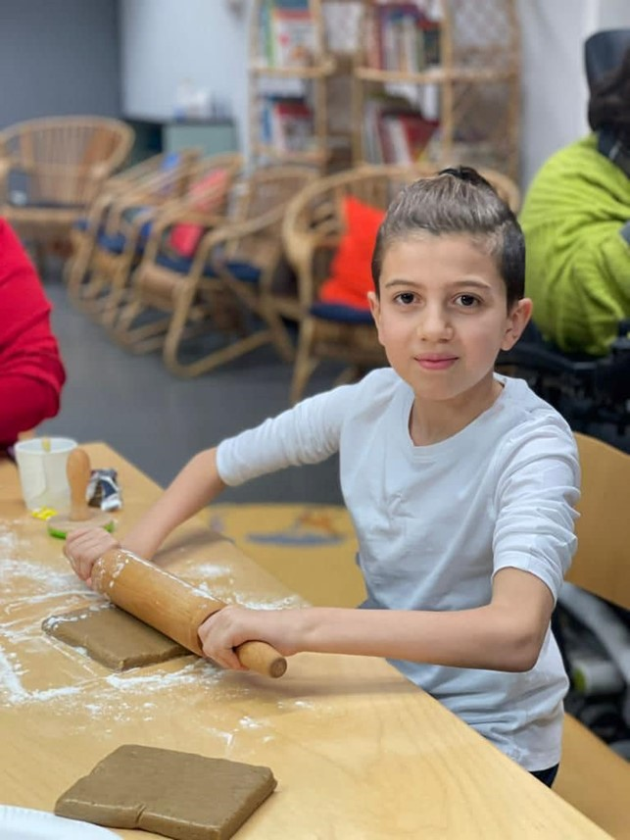
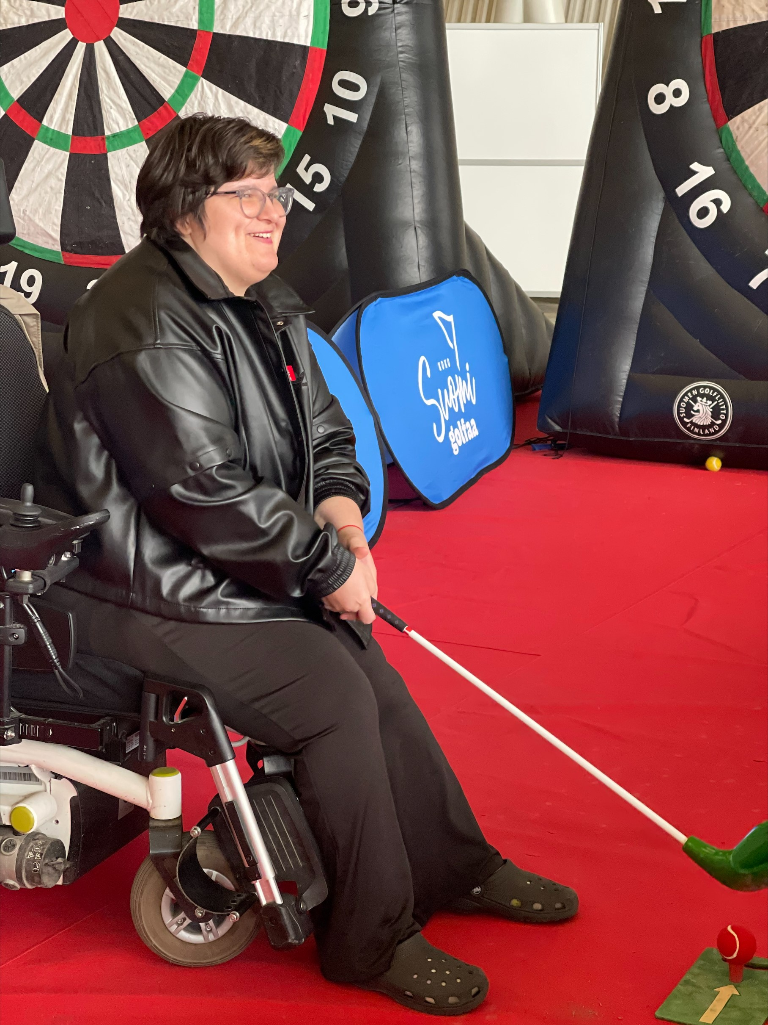
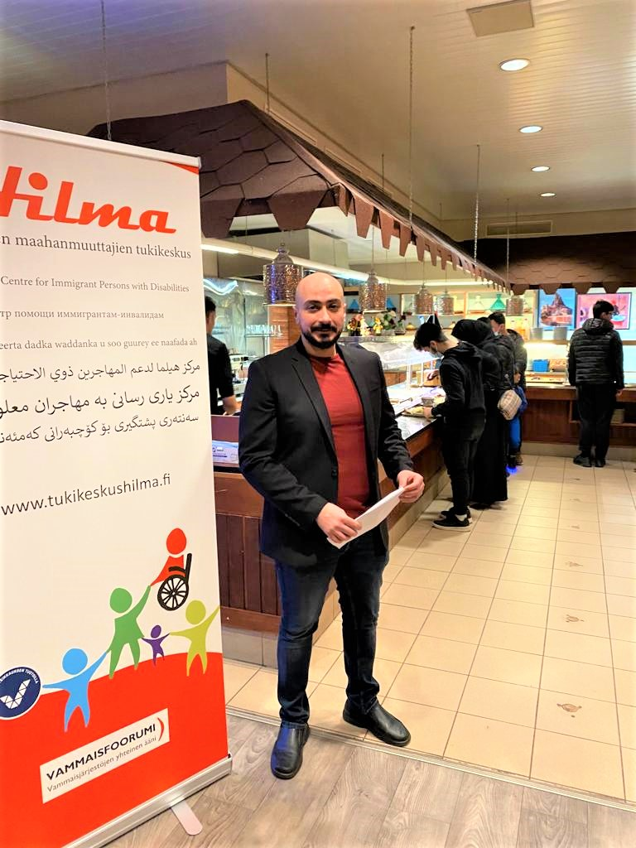
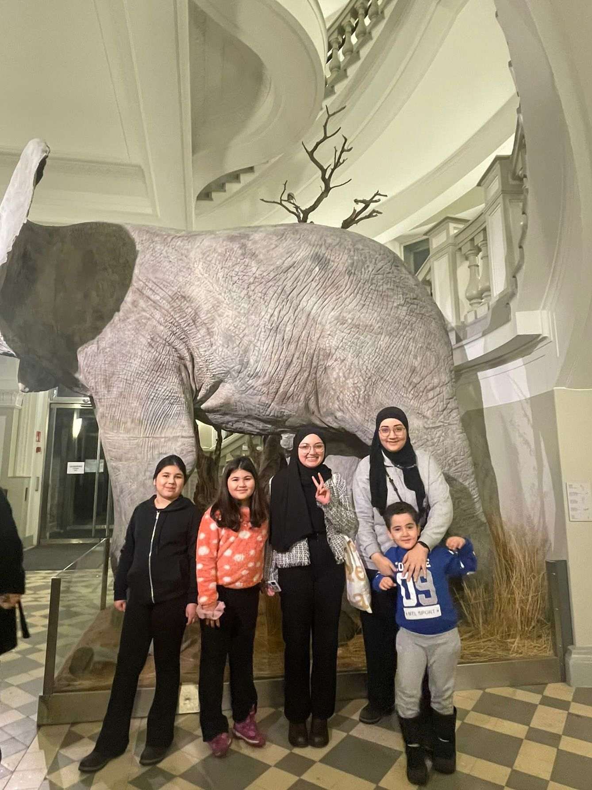
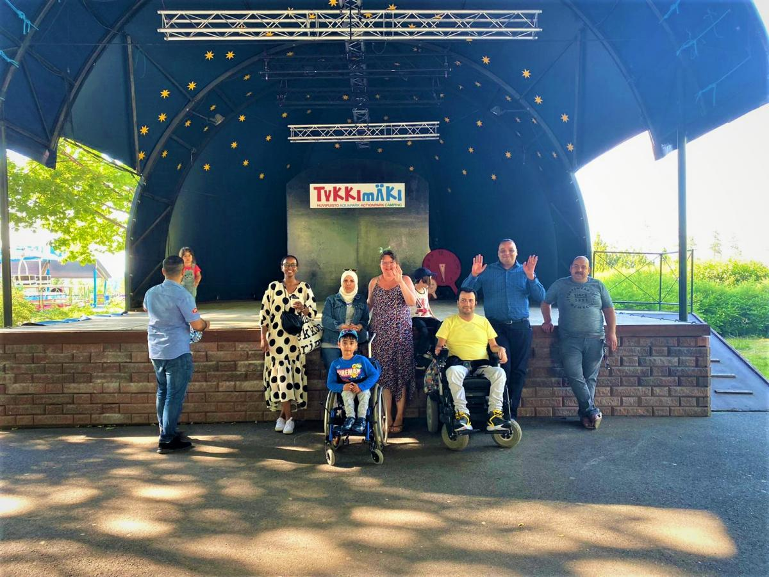




Slide 25
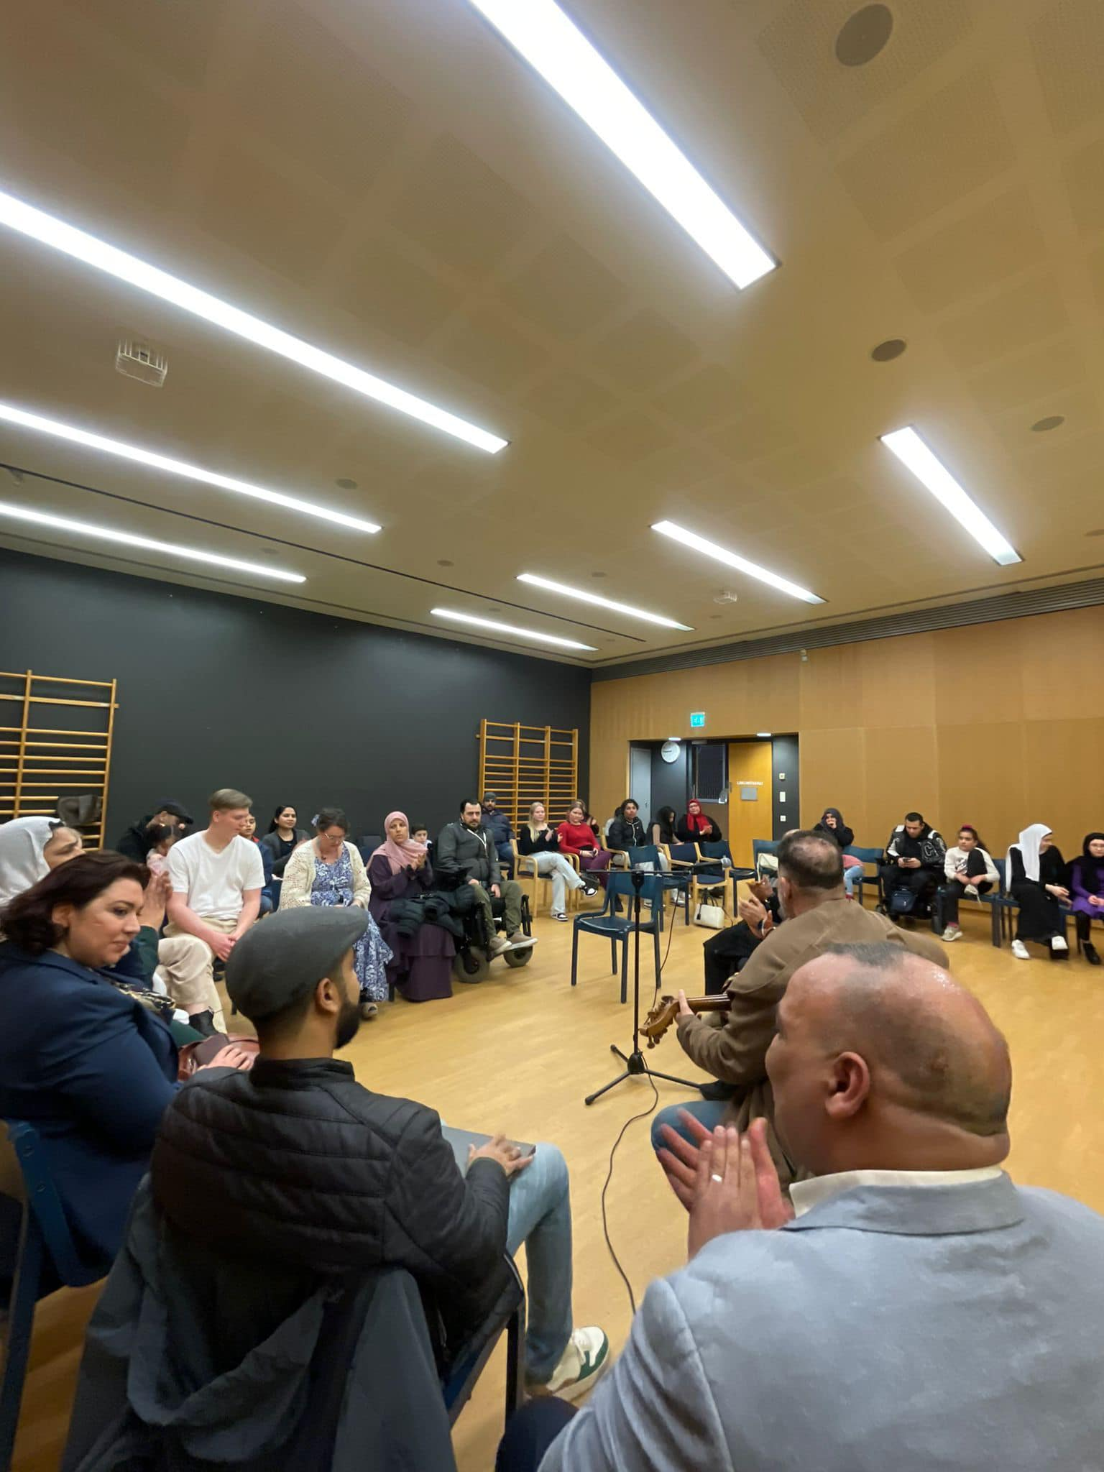
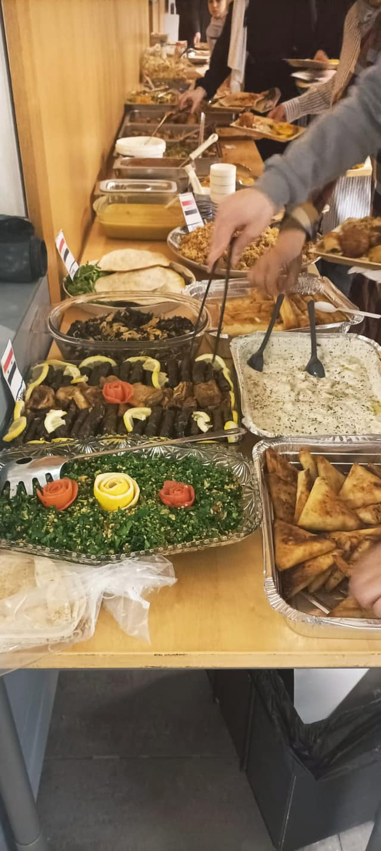
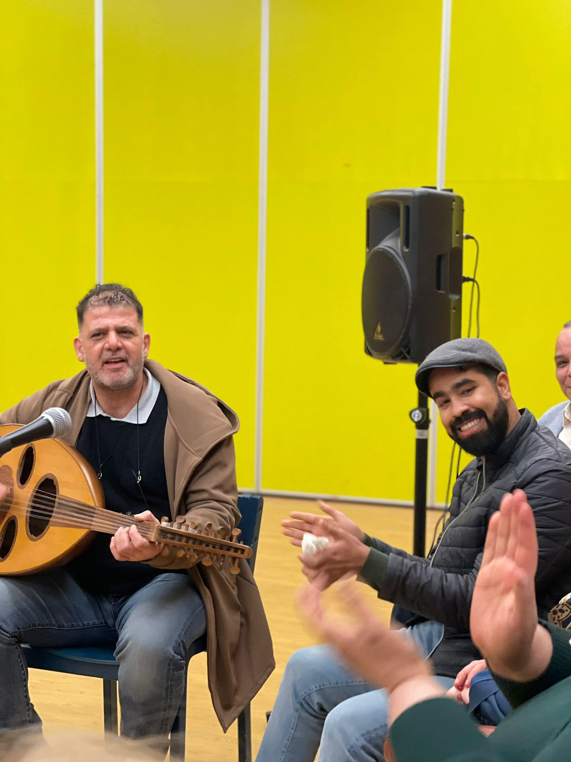
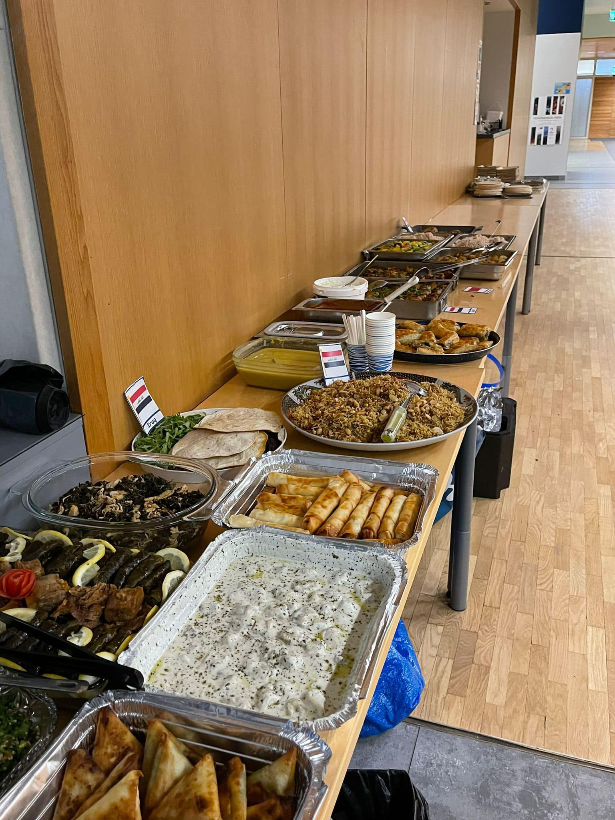

Slide 26
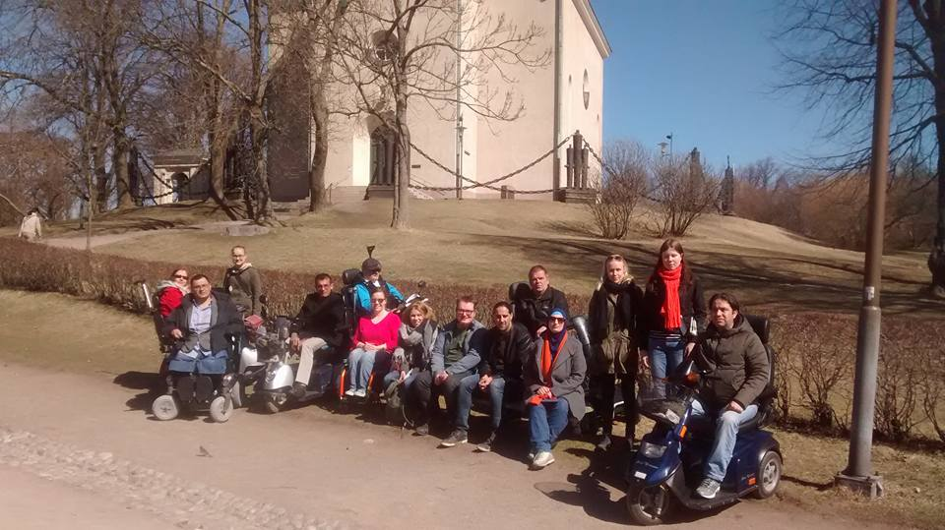
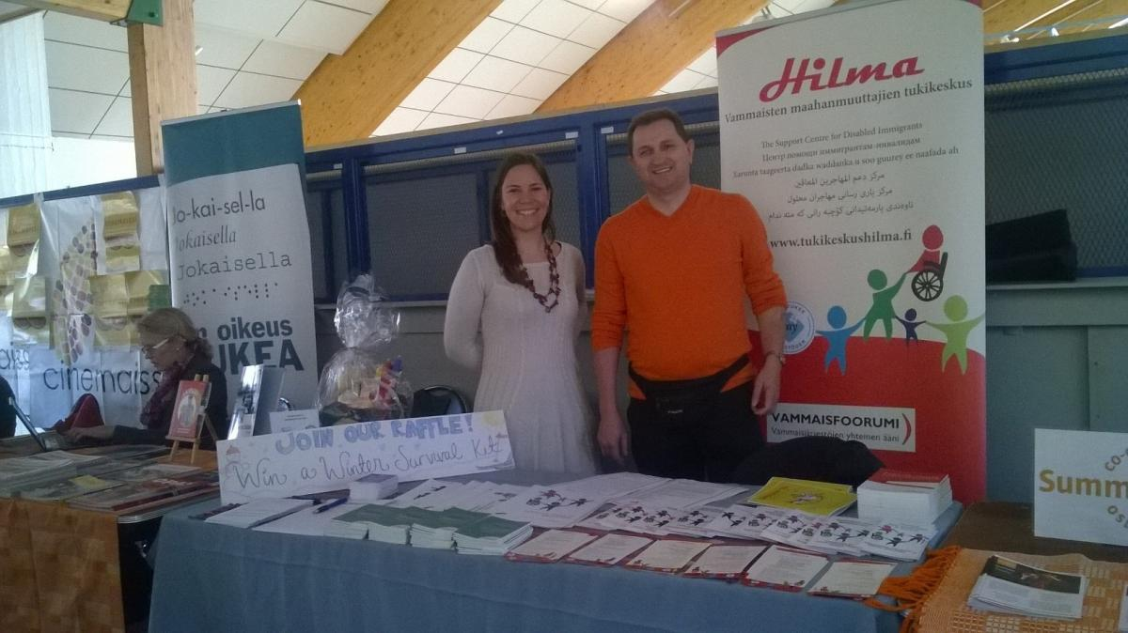
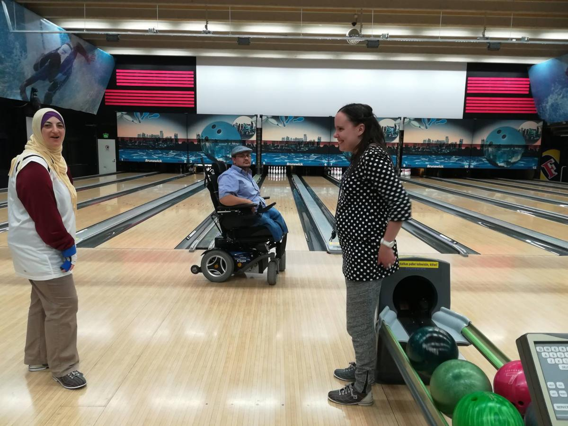
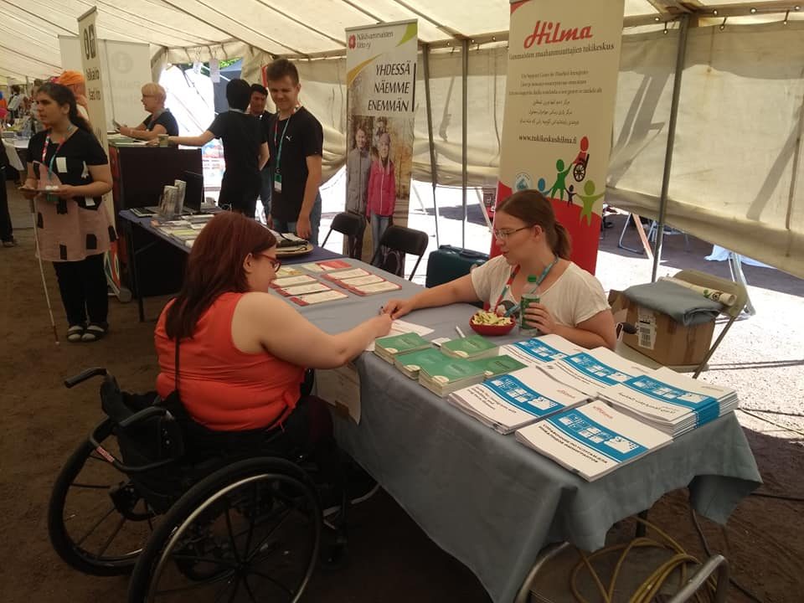

Slide 27
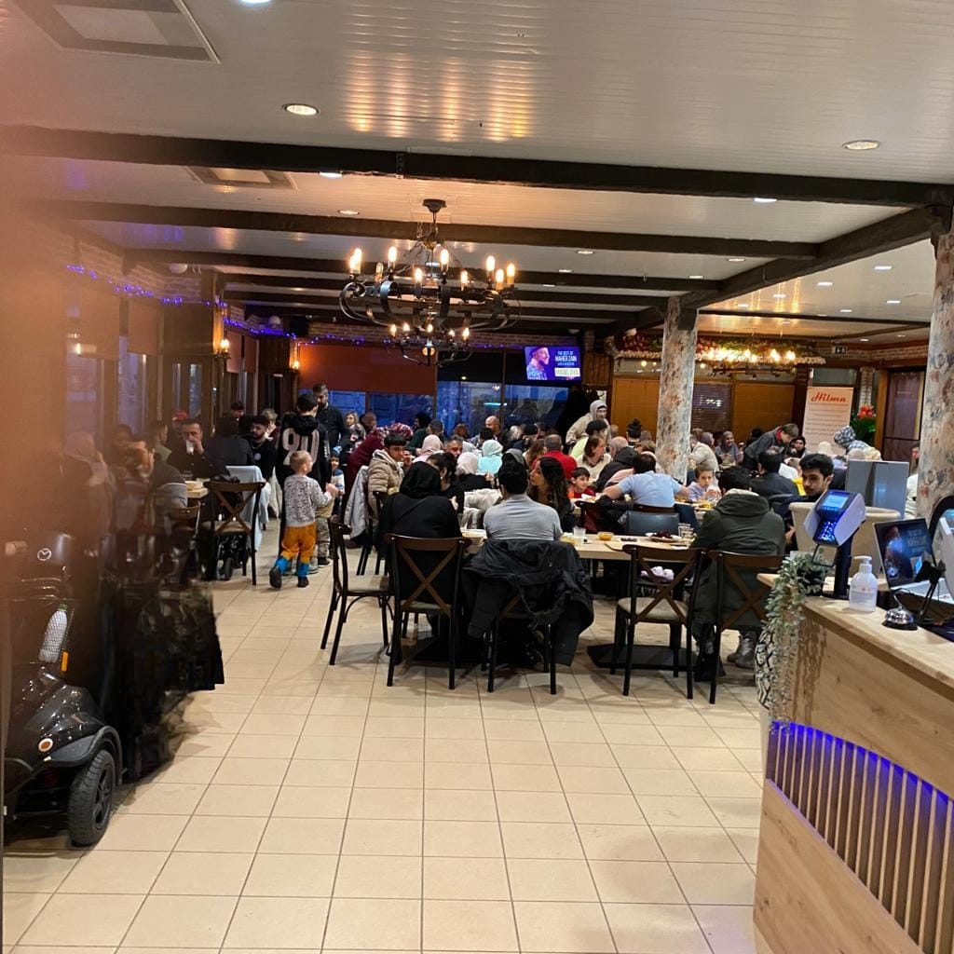

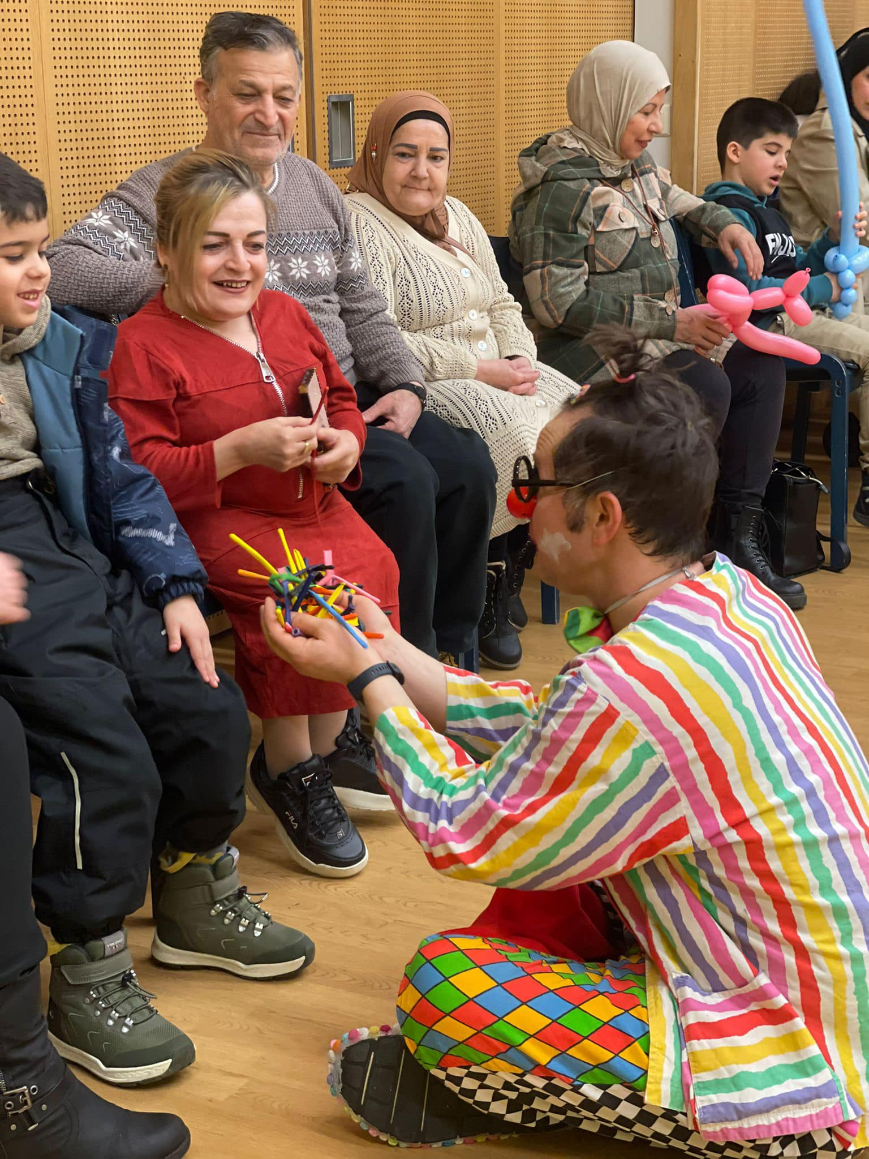

Slide 28
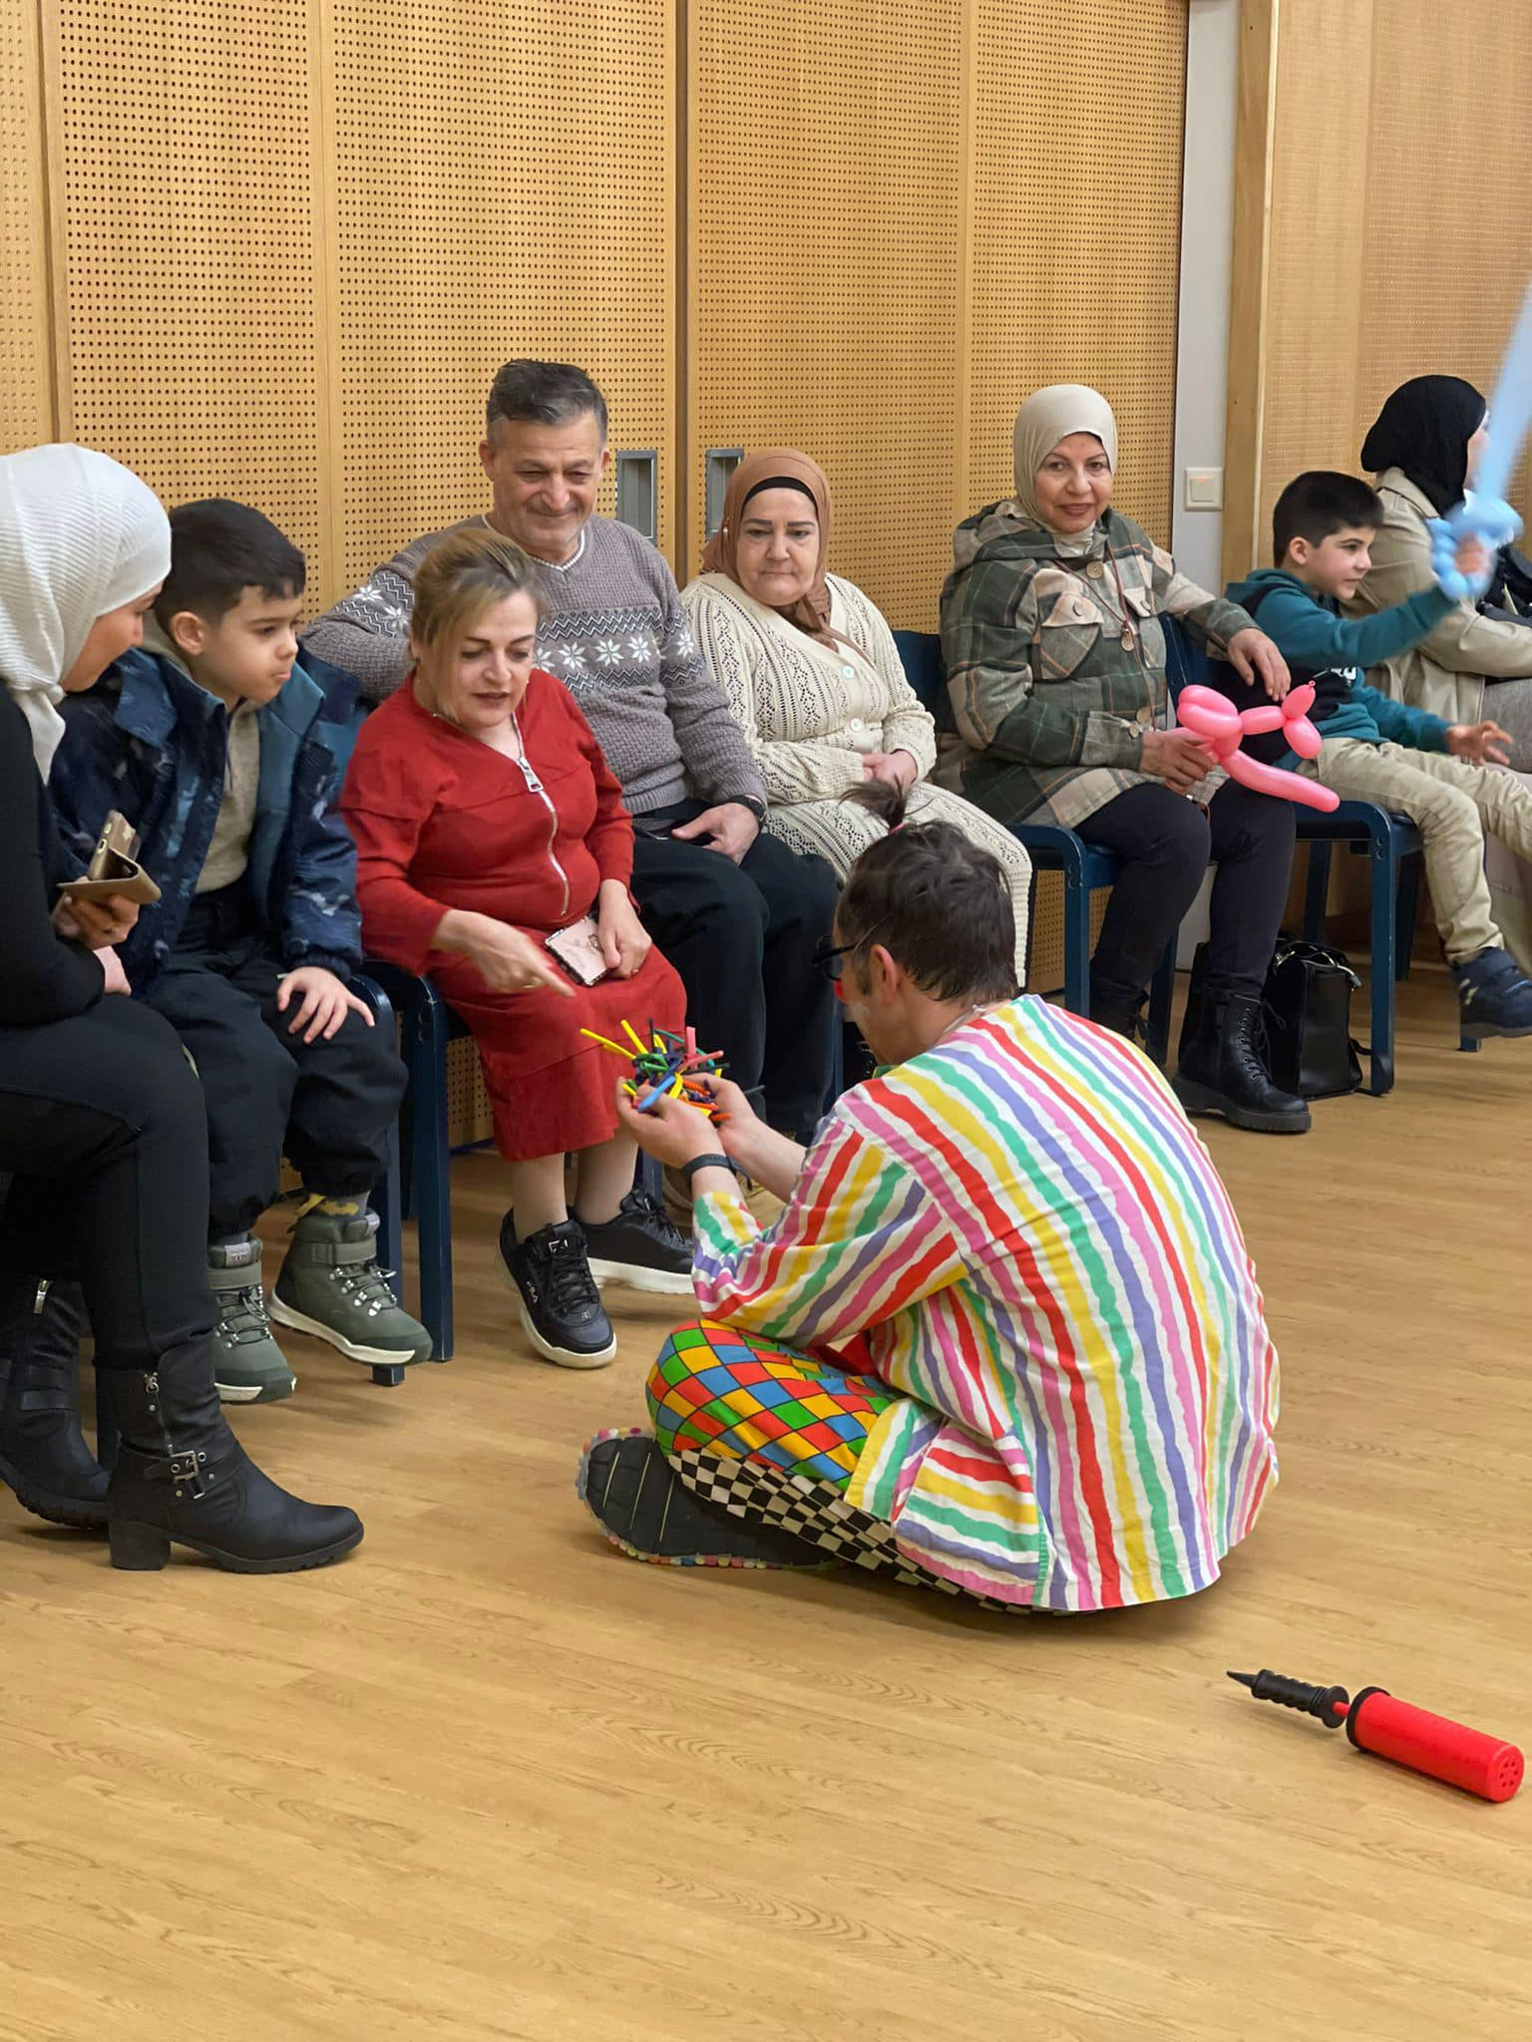
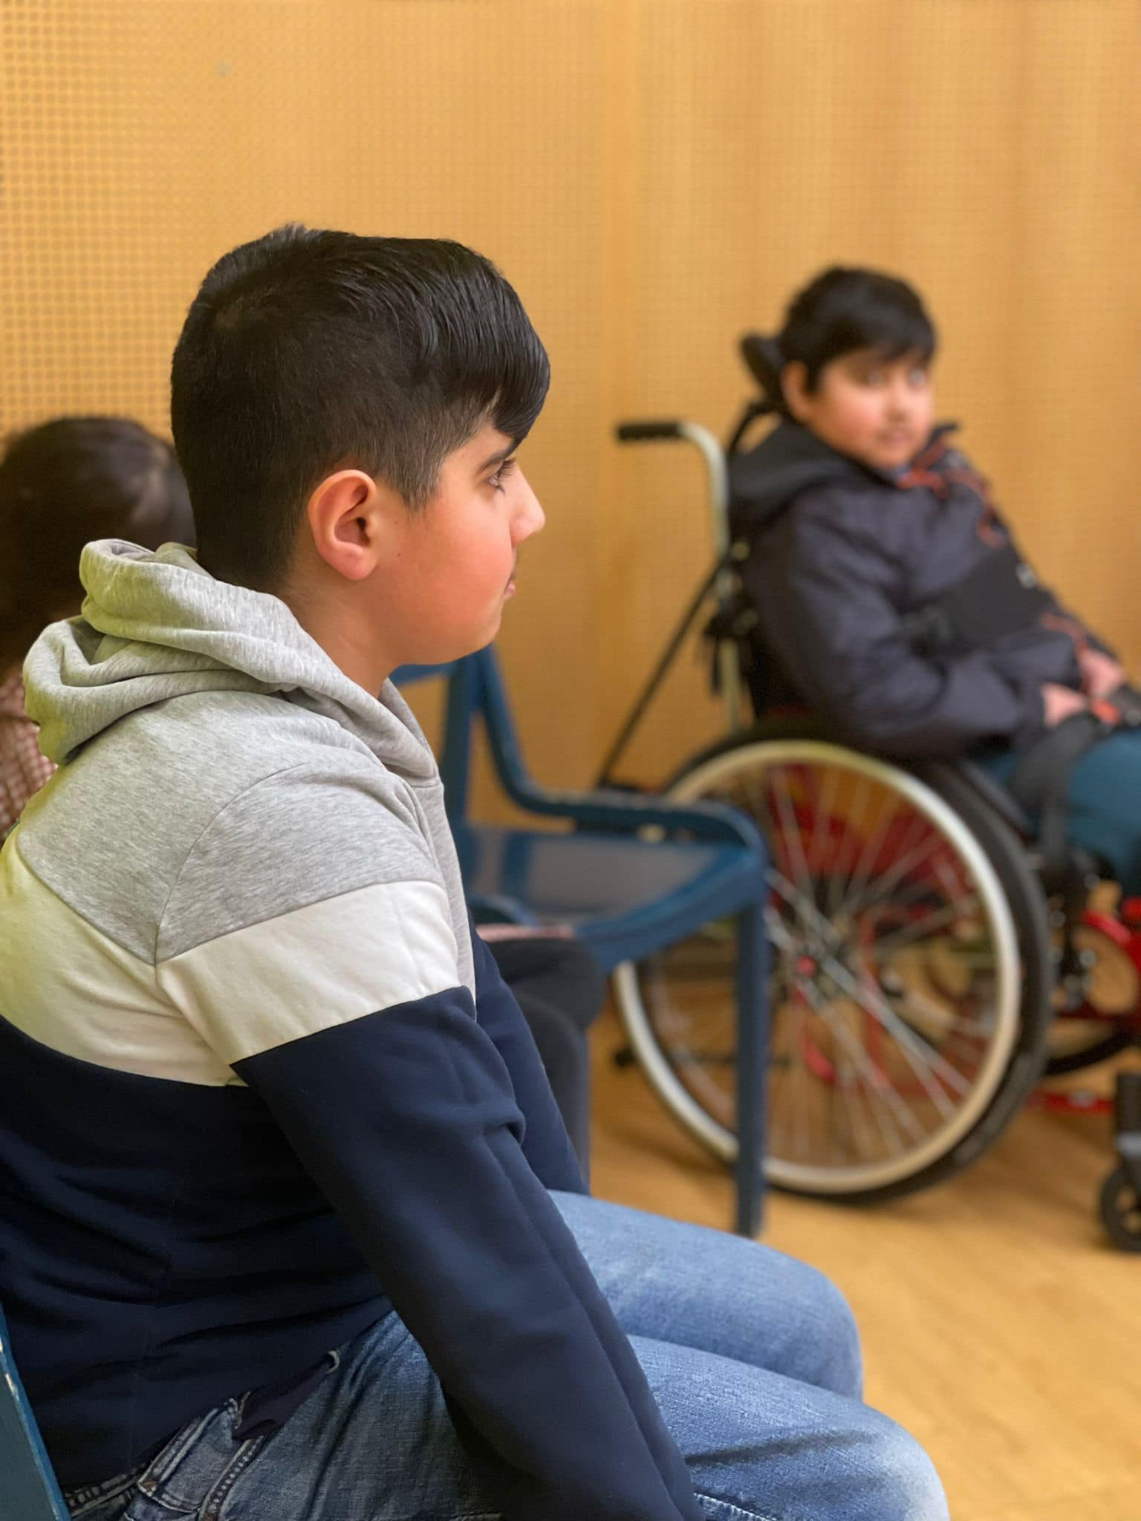
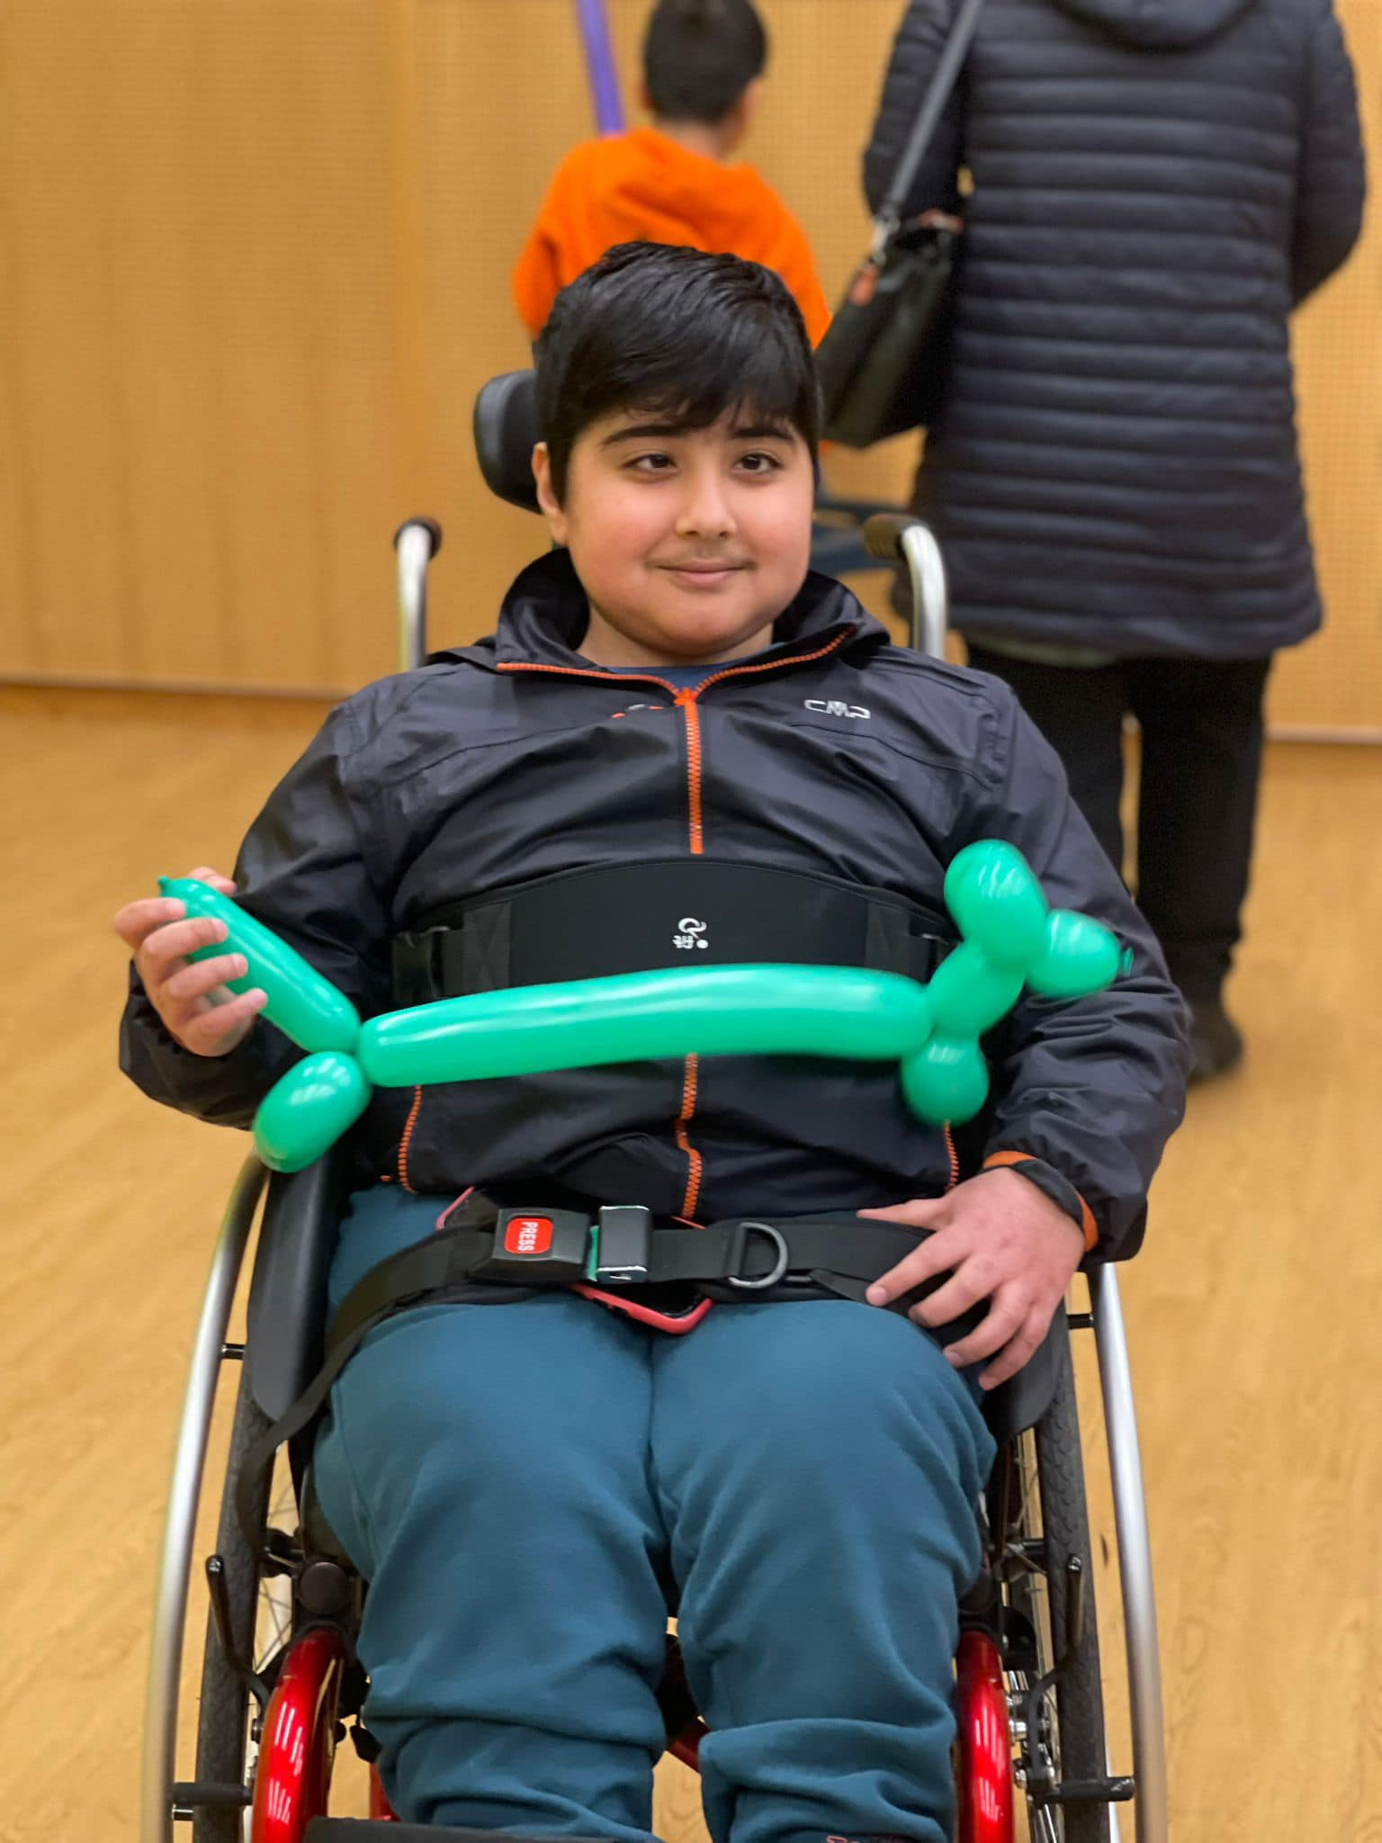
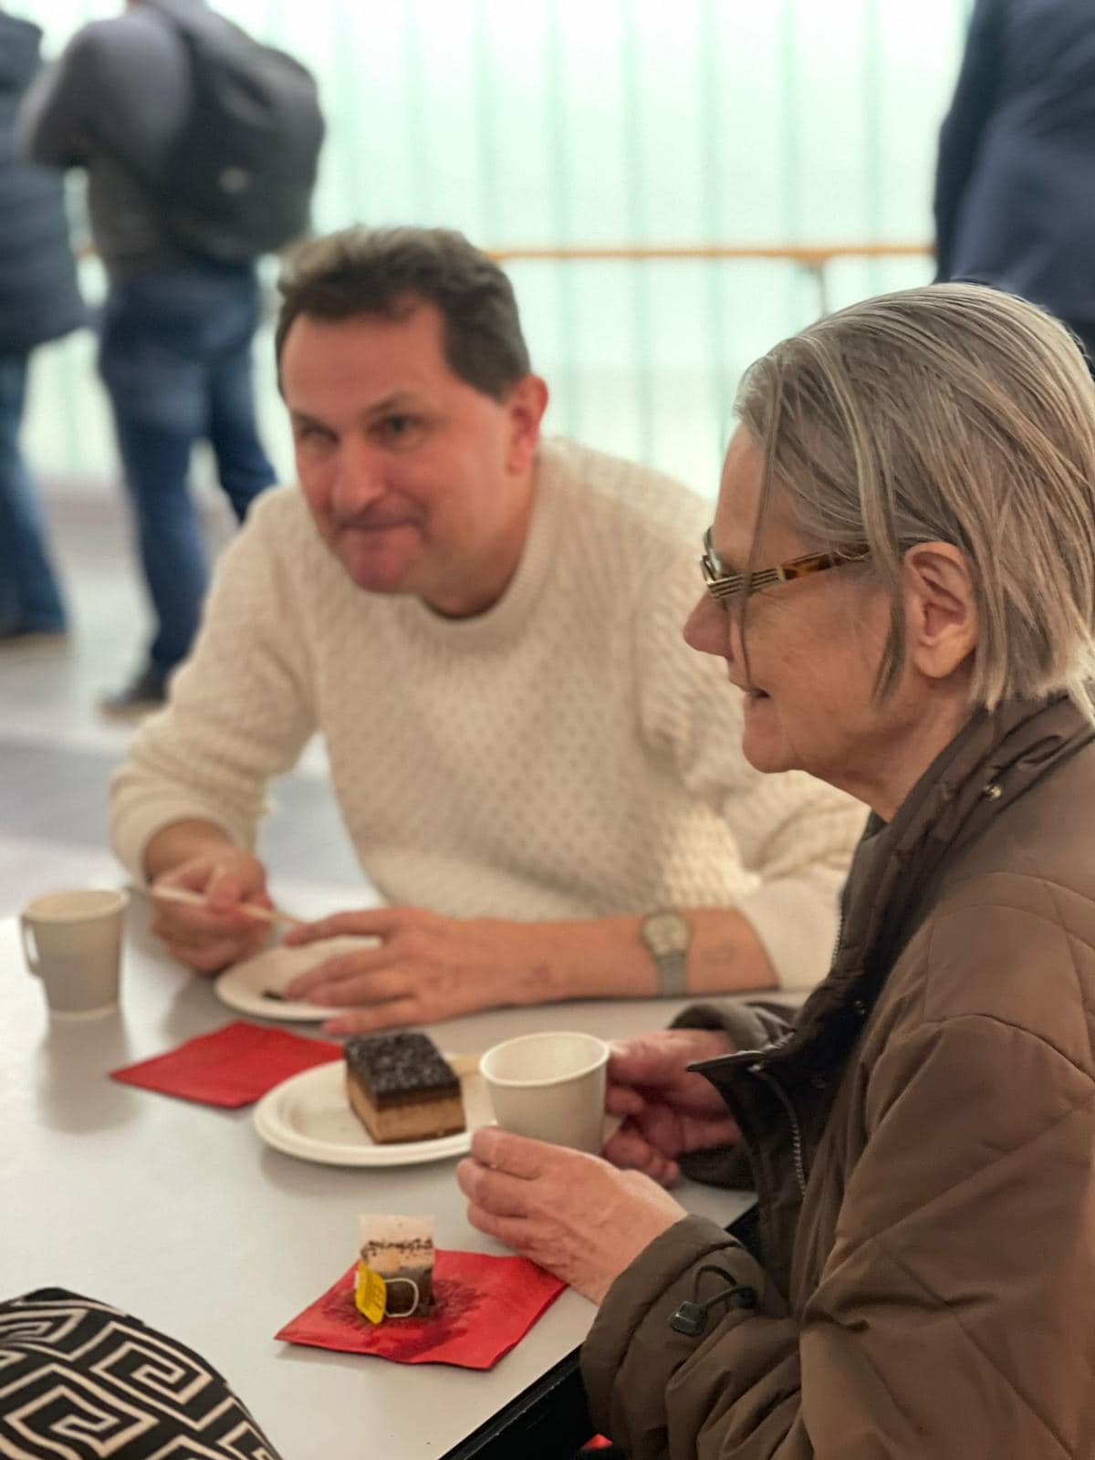

Slide 29
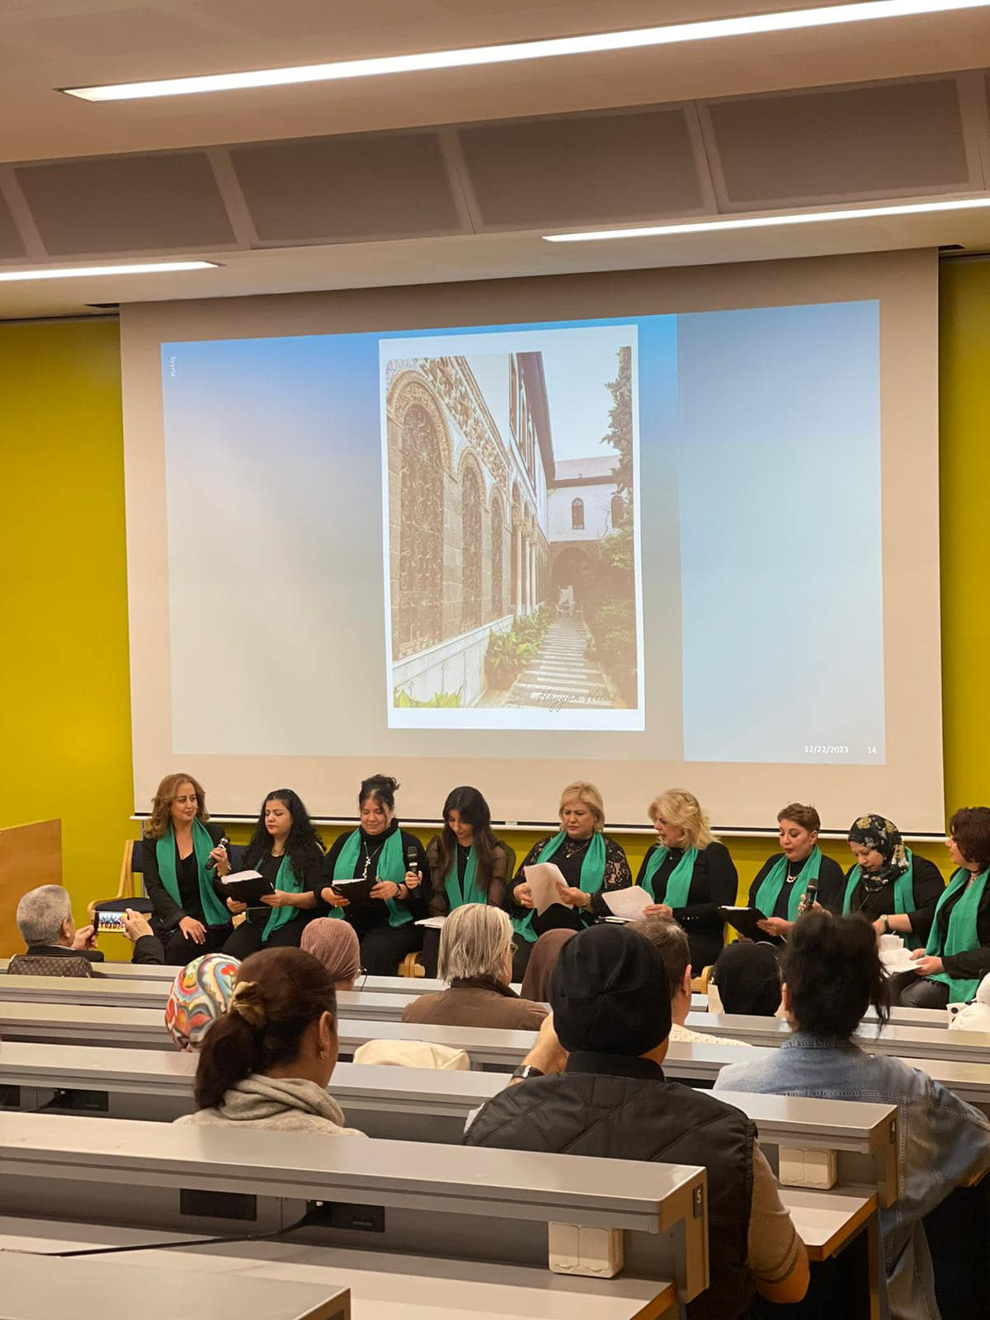




Slide 30





Slide 31





Slide 32





Slide 33





Slide 34


Questions and discussion welcome
www.tukikeskushilma.fi

